Slide 1
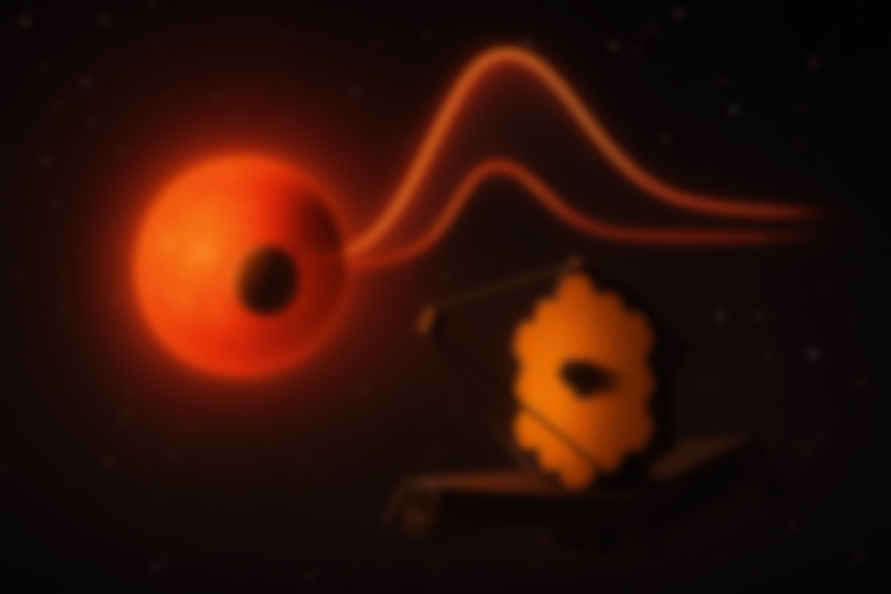
Thermal Emission from Rocky Exoplanets as a Probe of Their Atmospheres in the JWST Era
Patcharapol (Pat) Wachiraphan
PhD Candidate
Dept. of Astrophysical & Planetary Sciences
University of Colorado Boulder, USA
PSURE2025, Dept. of Physics, Faculty of Science, Mahidol University, Bangkok, Thailand (June 9th 2025)
Background picture:
artist (chatgpt) impression
Notes:
Good morning, everyone! Thank you for joining me today. My name is Pat Wachiraphan, and I’m a PhD candidate at the University of Colorado Boulder working with Dr. Zach Berta-Thompson and Dr. Hannah Diamond-Lowe. Today, I’m excited to share a summary of what we learn about LTT 1445A b thermal emission spectrum using JWST MIRI/LRS.

Slide 2
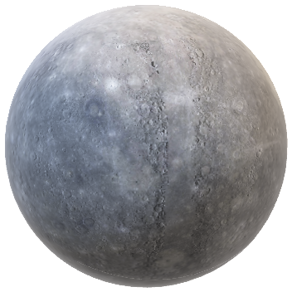
What do we know about the atmospheres of rocky planets?
Credit: NASA Visualization Technology Applications and Development (VTAD)
Mercury
Almost no atmosphere (~10⁻¹⁴ bar)
Hot on the dayside (~700 K; 430℃)/ cold on the nightside (90 K; -180℃)
Equilibrium temperature ~448 K
Venus
Thick CO₂ atmosphere (92 bar)
Hot with well-distributed temperature at ~737 K (464 ℃)
Equilibrium temperature ~328 K
What if Venus gets hotter? Or Mercury gets bigger?
Credit: NASA/JPL-Caltech
Notes:
- Mercury no atmosphere hot dayside cold nightside.
- Venus thick atmosphere well distributed heat.
-boundary?

Slide 3
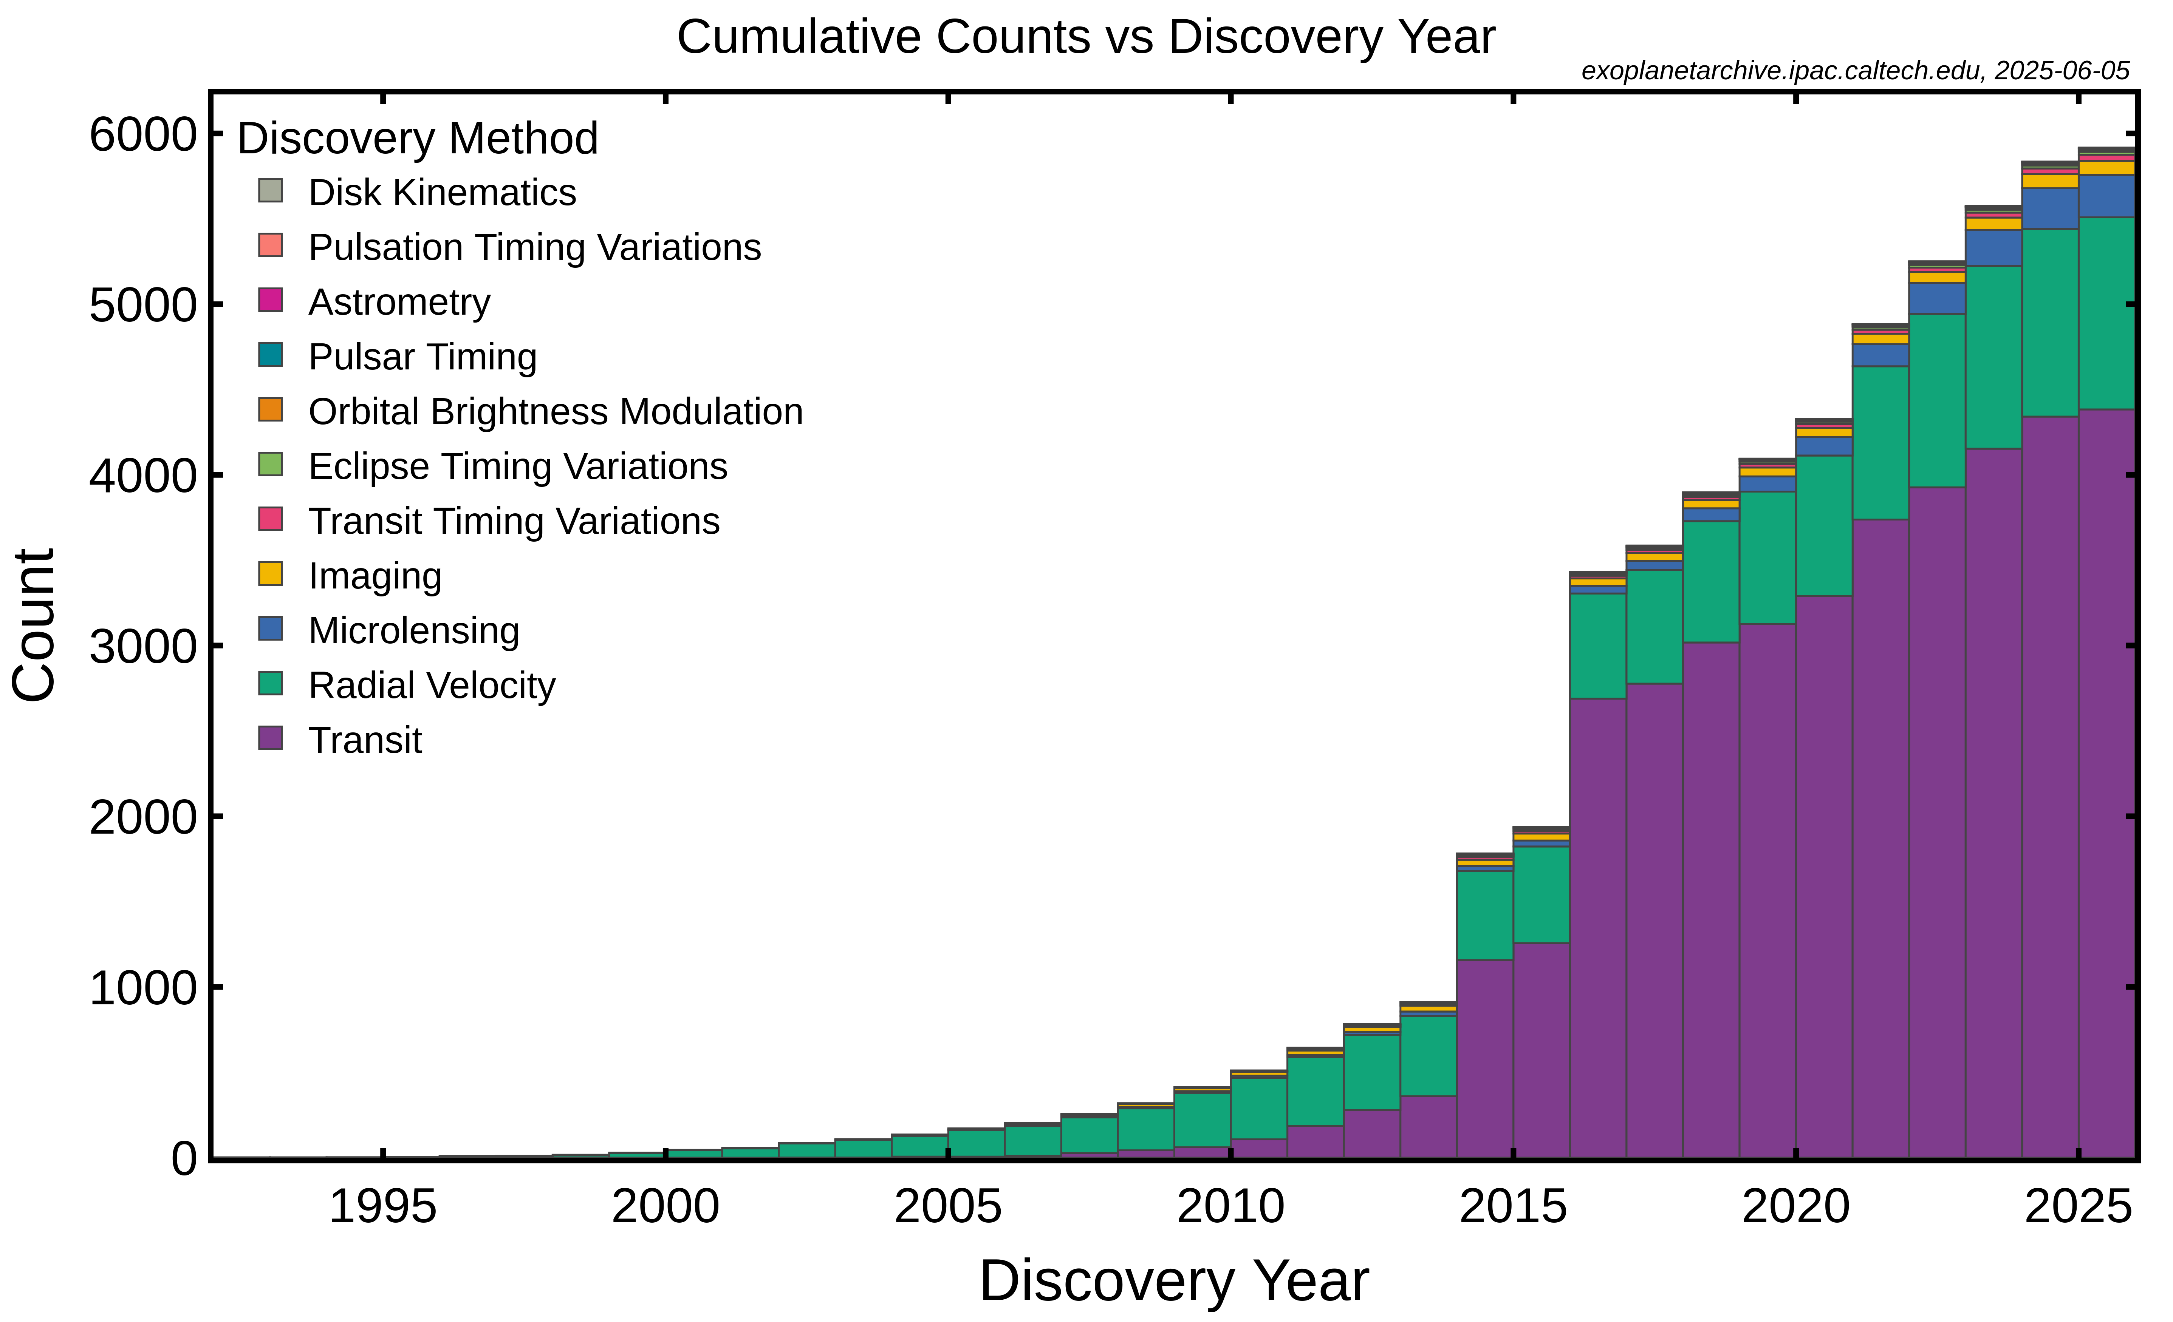
Exoplanets: Keys to Understanding Planets
5,905 Exoplanets have been discovered to date.
Detection methods:
Transit ~74.2 %
Direct Imaging ~1.4%
Radial Velocity ~19.0%
Microlensing ~4.1%
Etc.
Atmospheric Studies
Notes:
- exoplanet as a key to understand planet.
- 5514 exoplanets eg. Planet formation and evolution.
- Transit
- able to study atmosphere
- Study atmosphere of rocky exoplanet is hard small signal

Slide 4
But rocky exoplanet is small!

Slide 5
M-dwarf opportunity (or not?)
Signal of transiting exoplanet depends on the planet-to-star radius ratio squared (R_{p}/R_{s})²
M-dwarf have radius ~0.1 – 0.6 R☉
More abundance
M-dwarf make up ~75% of all stars in our galaxy (Henry et al. 2006).
Sun
M3
M6
0.15 R☉
M6
Earth
0.009 R☉
M3
0.45 R☉
Notes:
- signal depends on radius ratio 2
- goes to lower Rs (M-dwarf)
- more abundance

Slide 6
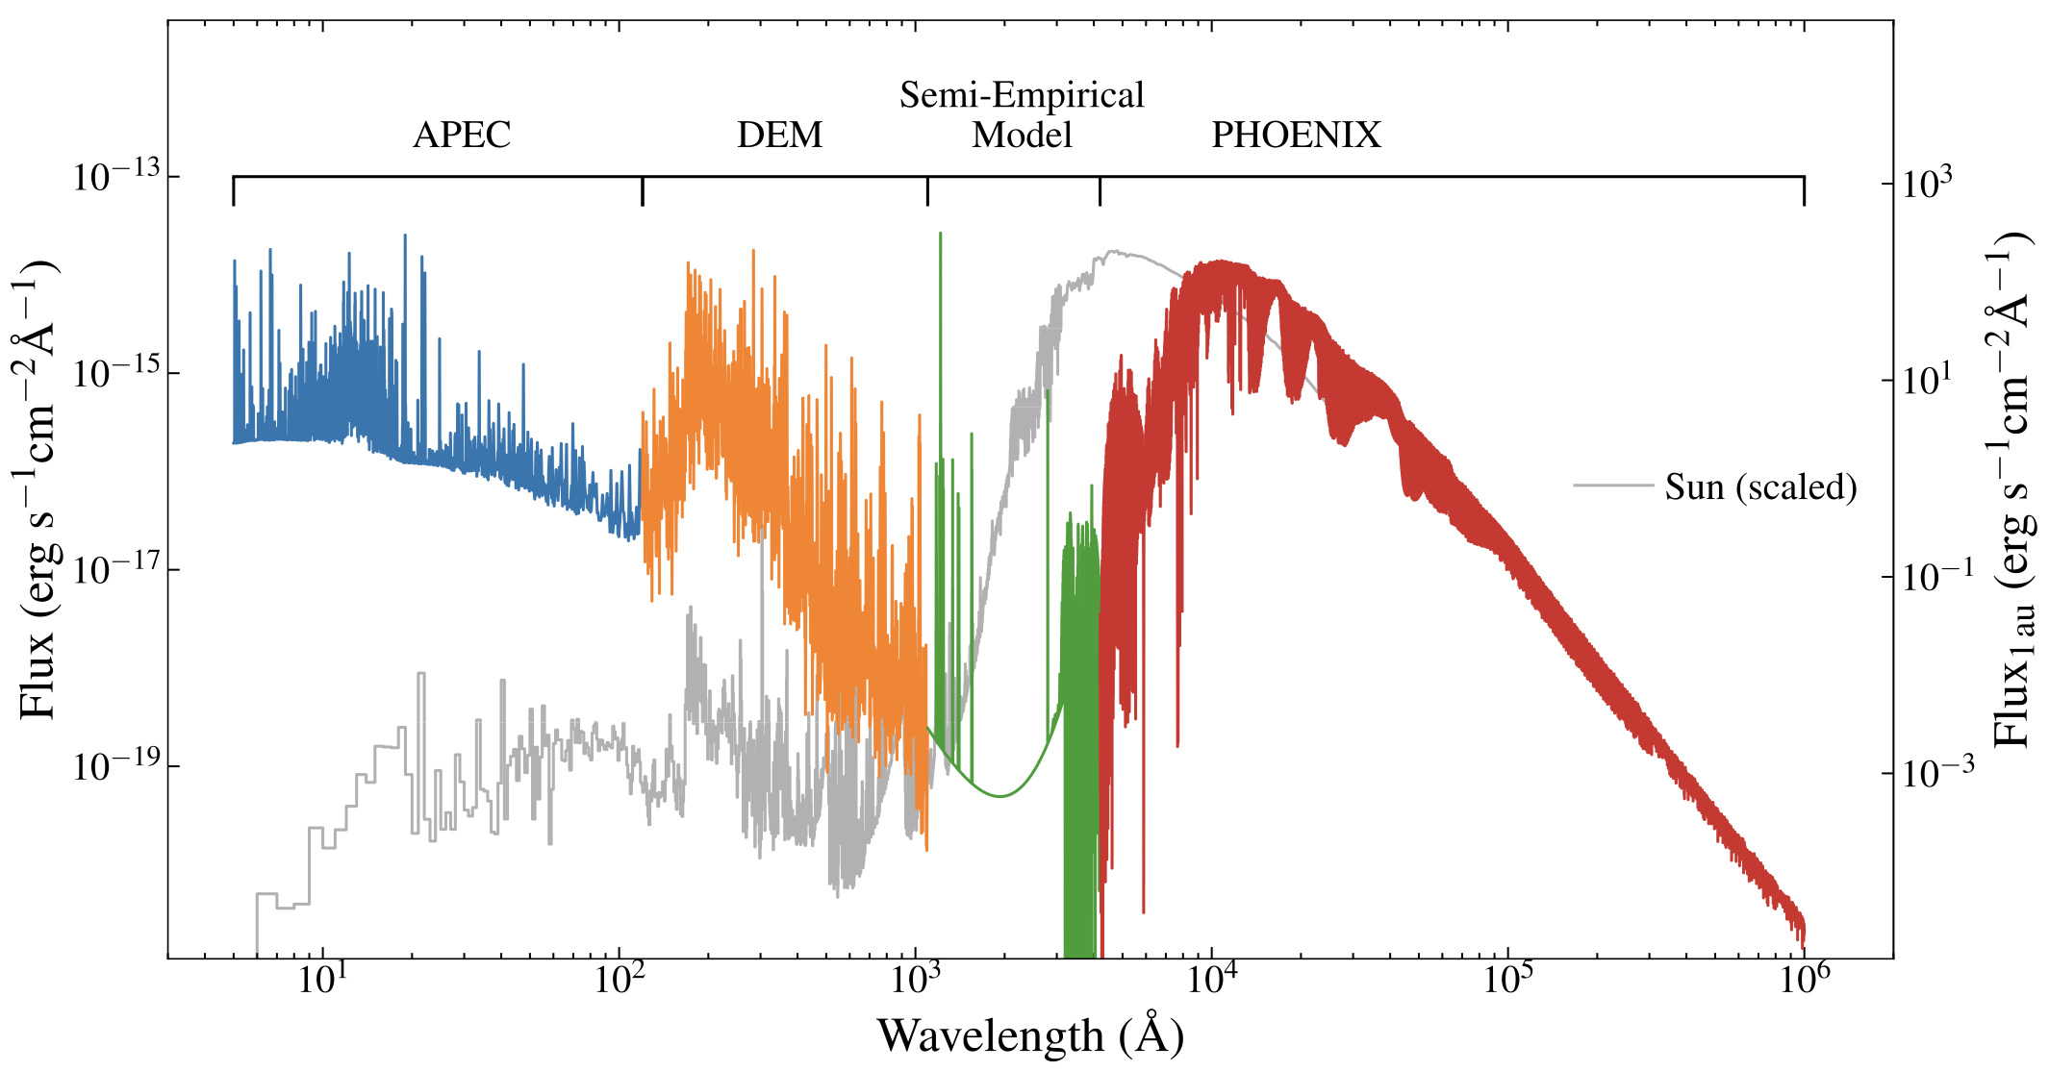
M-dwarf opportunity (or not?)
Active?
Primary atmosphere escape
Secondary atmosphere
Semiempirical model spectrum of TRAPPIST-1
Credit: Wilson, D. et al. 2021
Notes:
-atmosphere of rocky exoplanet?
-active XUV flux long lasting
- primary atmosphere escape
- H/He atmosphere

Slide 7
Research question?
Do terrestrial exoplanets around M-dwarf have an atmosphere/what kind?
What is the method should be used?
What target to observe?
What instrument should be used?
Notes:
Research question
- method
- target
- instrument

Slide 8
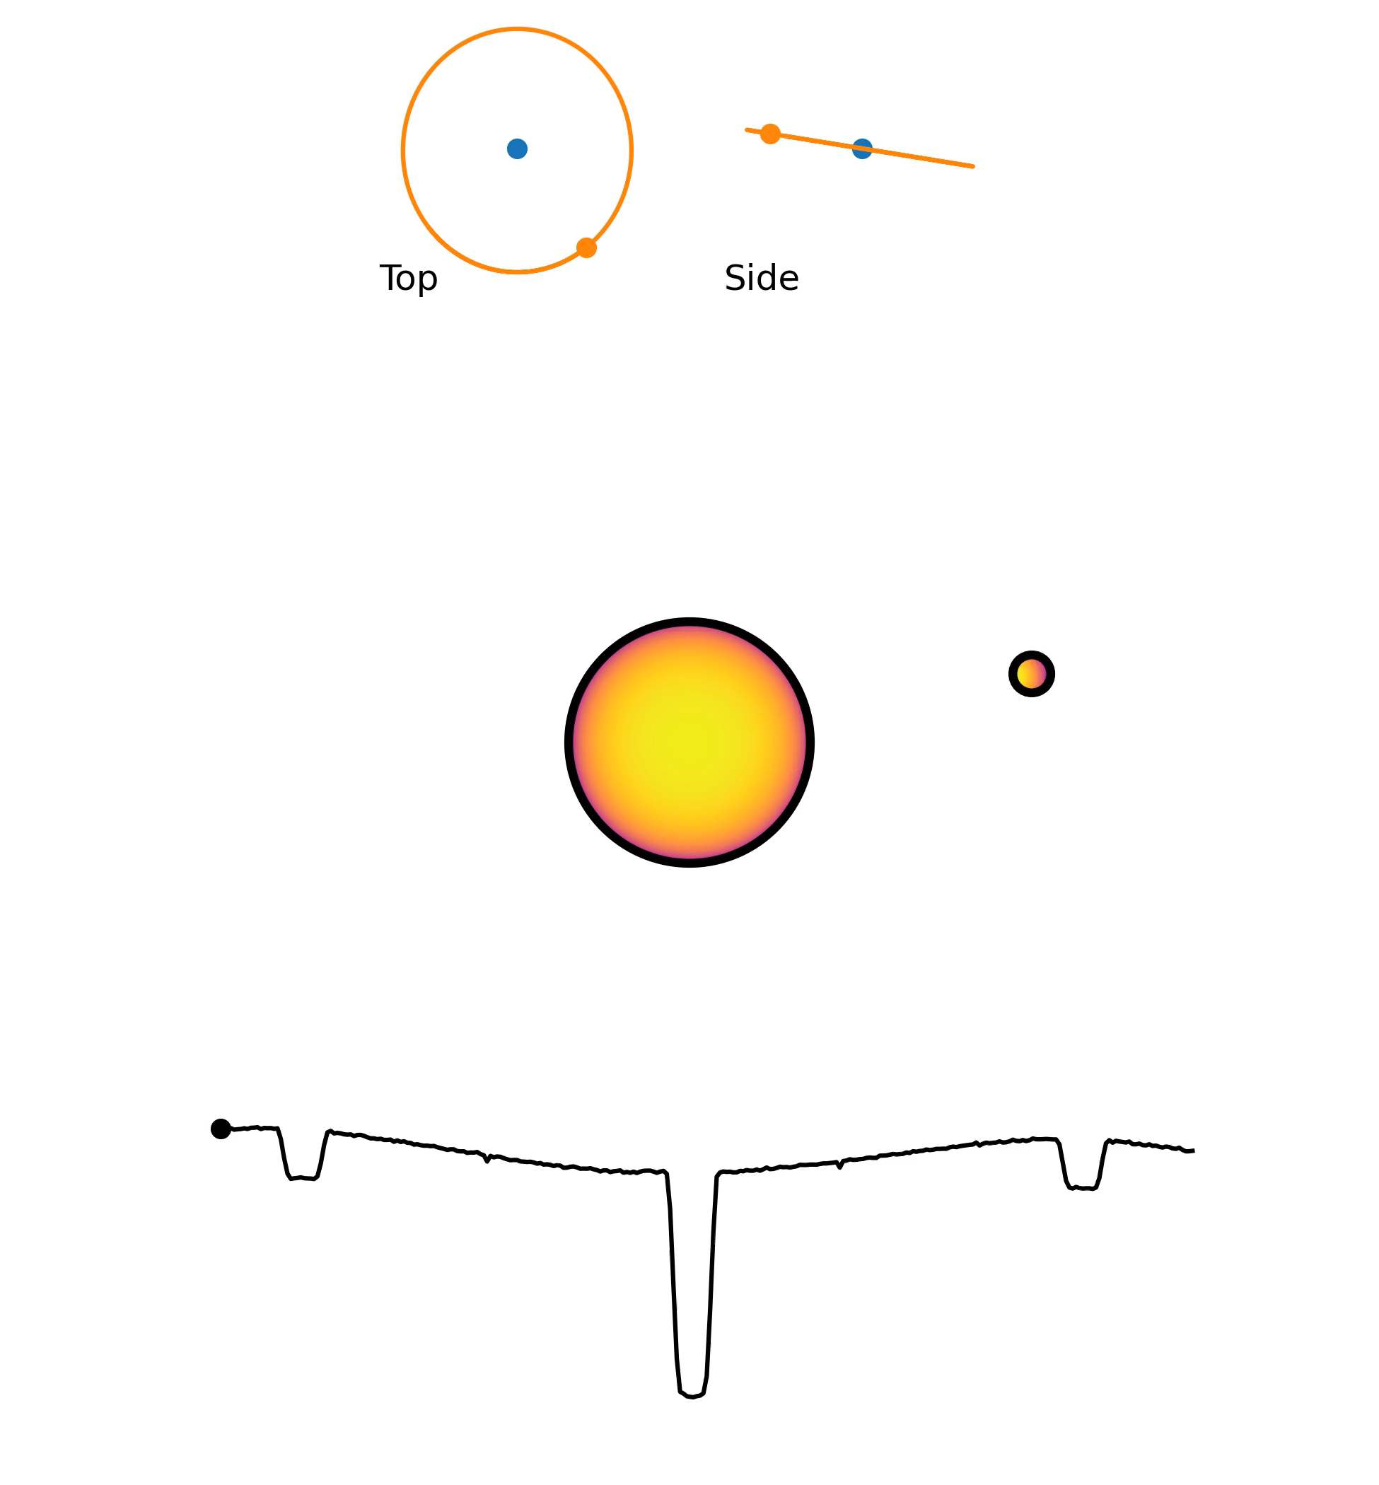
Transiting exoplanets
Light curve morphology
Transit (Star - Planet shadow)
Phase curve (Star + Planet at that phase)
Secondary eclipse (Star alone)
Exoplanet that we study usually tidally lock
Transit (star – planet shadow)
Phase curve (star + planet @ phase)
Secondary eclipse (star alone)
WASP-43b orbital animation
(Credit: Catriona Murray)
Notes:
-Morphology
-We will used eclipse
-tidally lock

Slide 9
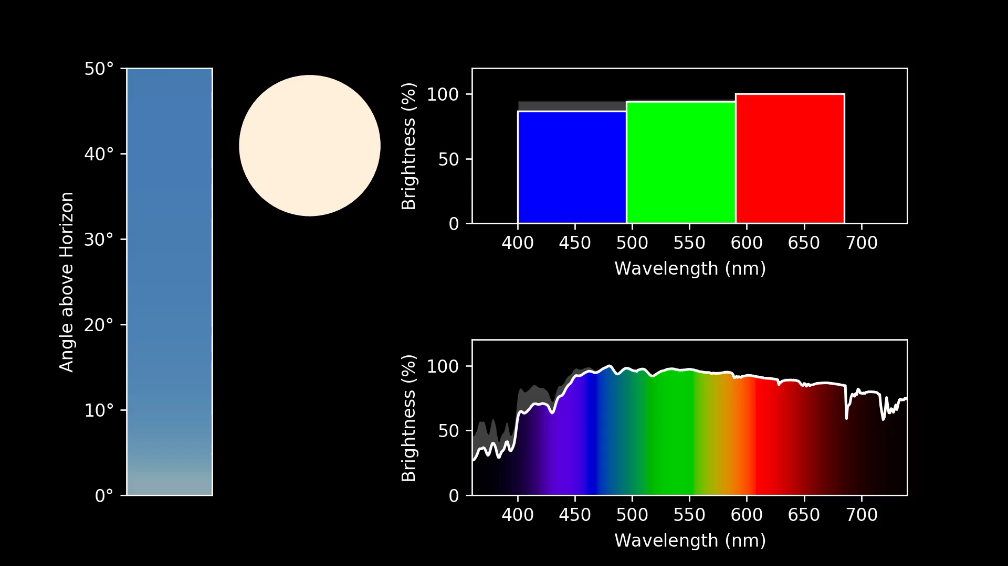
The Sun seen through Earth’s atmosphere:
O2
O2
Credit: Zach Berta-Thompson

Slide 10
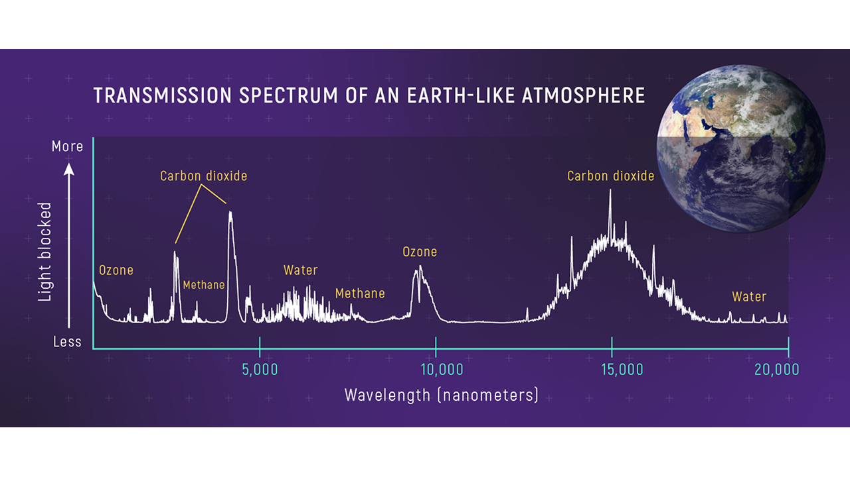
Transmission Spectrum of an Earth-like Atmosphere
Credit: NASA, ESA, Leah Hustak (STScI)
Transmission Spectroscopy
Earth as an exoplanet.
Notes:
-Morphology
-We will used eclipse
-tidally lock

Slide 11
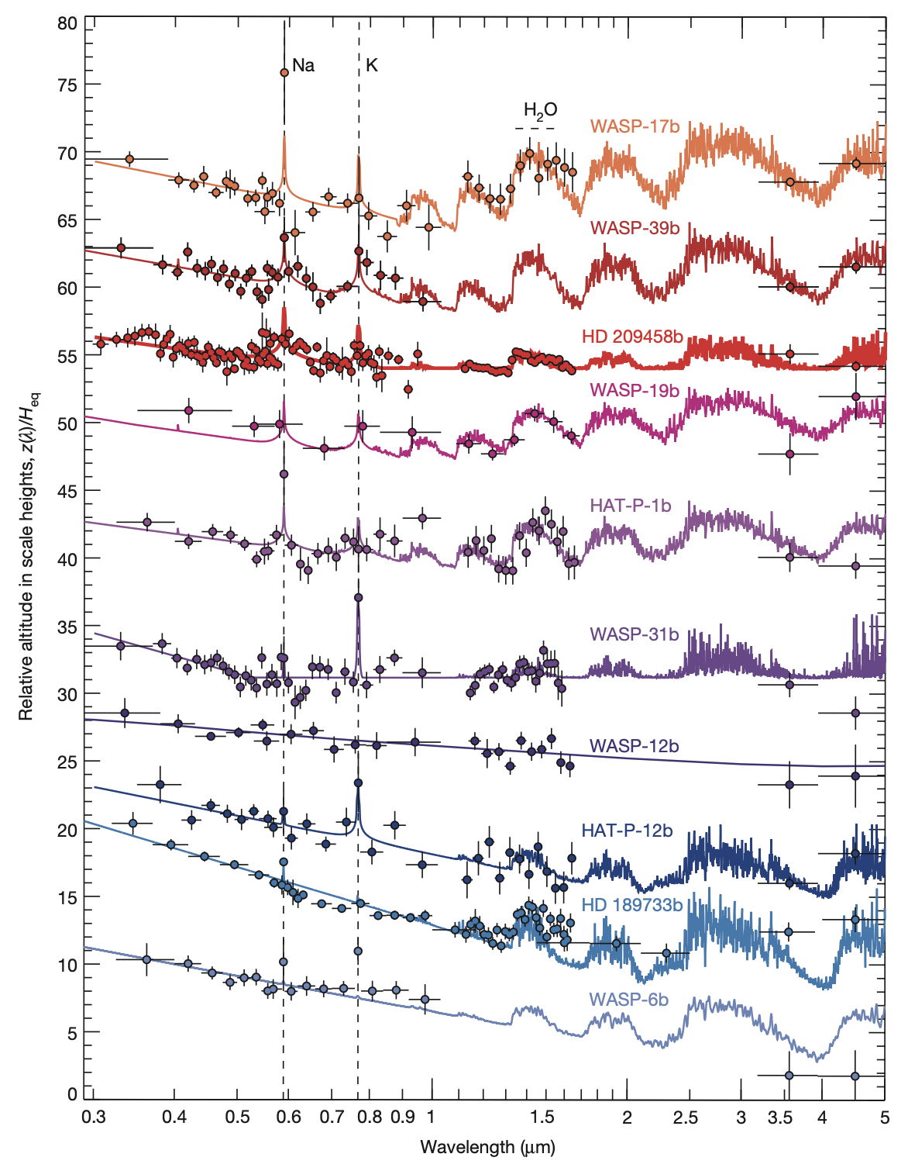
Transmission Spectroscopy
Observing the transit depth variation across wavelengths.
Successfully capture absorption features of gas giants.
Relative altitude in scale heights
HST/Spitzer transmission spectral sequence of hot-Jupiter survey targets
(Credit: Sing et al.2016 )
Wavelength (micron)

Slide 12
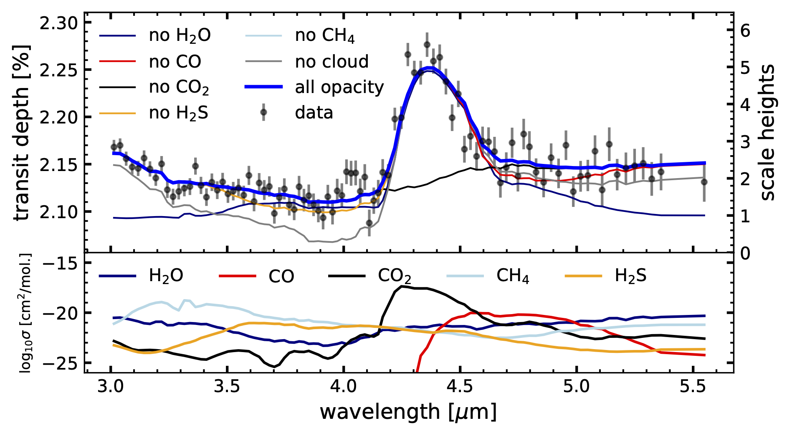
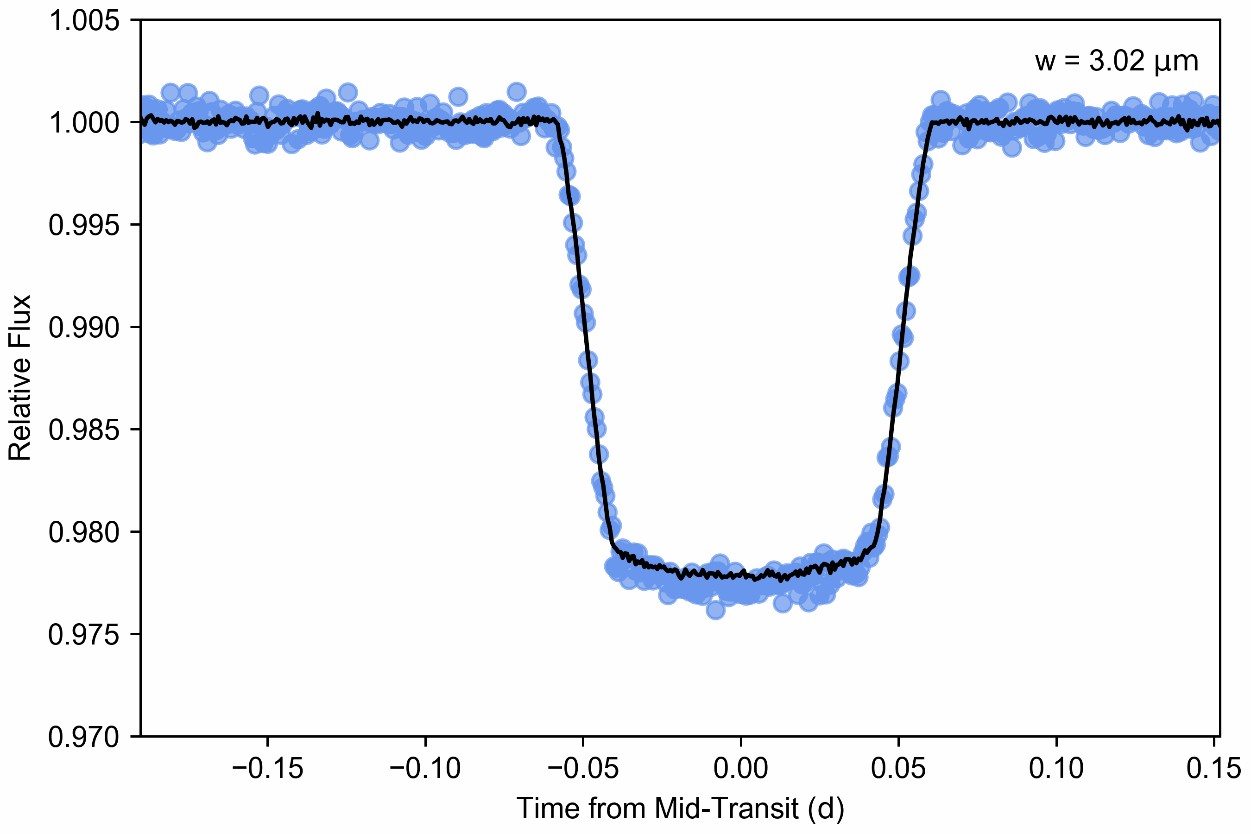
Transmission Spectroscopy
WASP-39b transit light curve in wavelengths
Credit: JWST Transiting Exoplanet Community ERS Team website/Pat Wachiraphan
WASP-39b transmission spectrum
(Credit: JWST Transiting Exoplanet Community ERS Team, 2022)

Slide 13
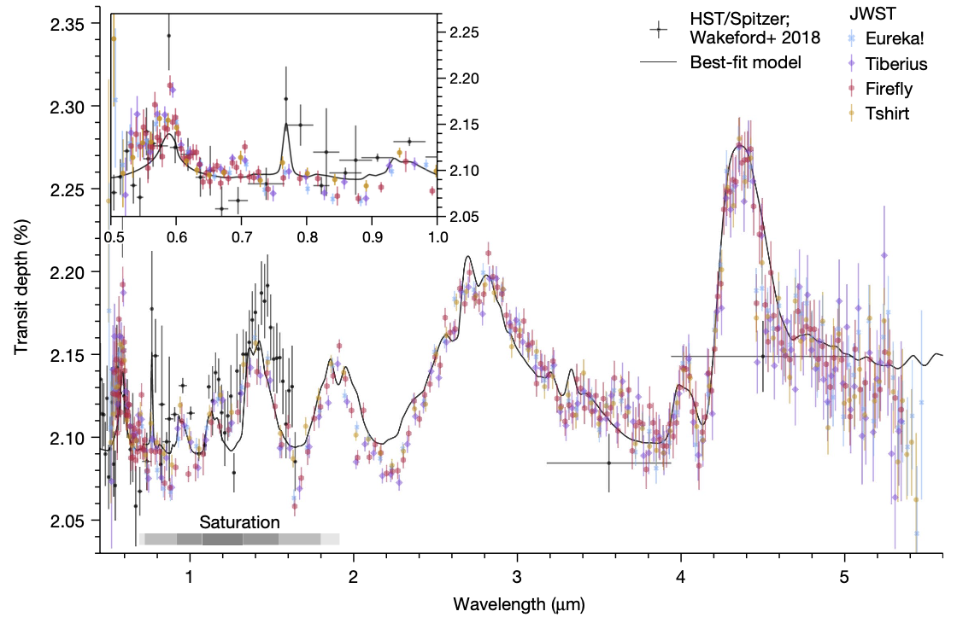
Transmission Spectroscopy
WASP-39b transmission spectrum (NIRSpec/PRISM)
(Credit: Rustamkulov, Z. et al. 2023)

Slide 14
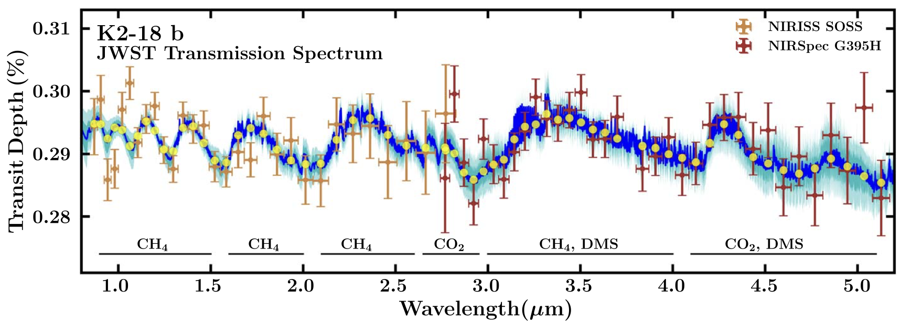
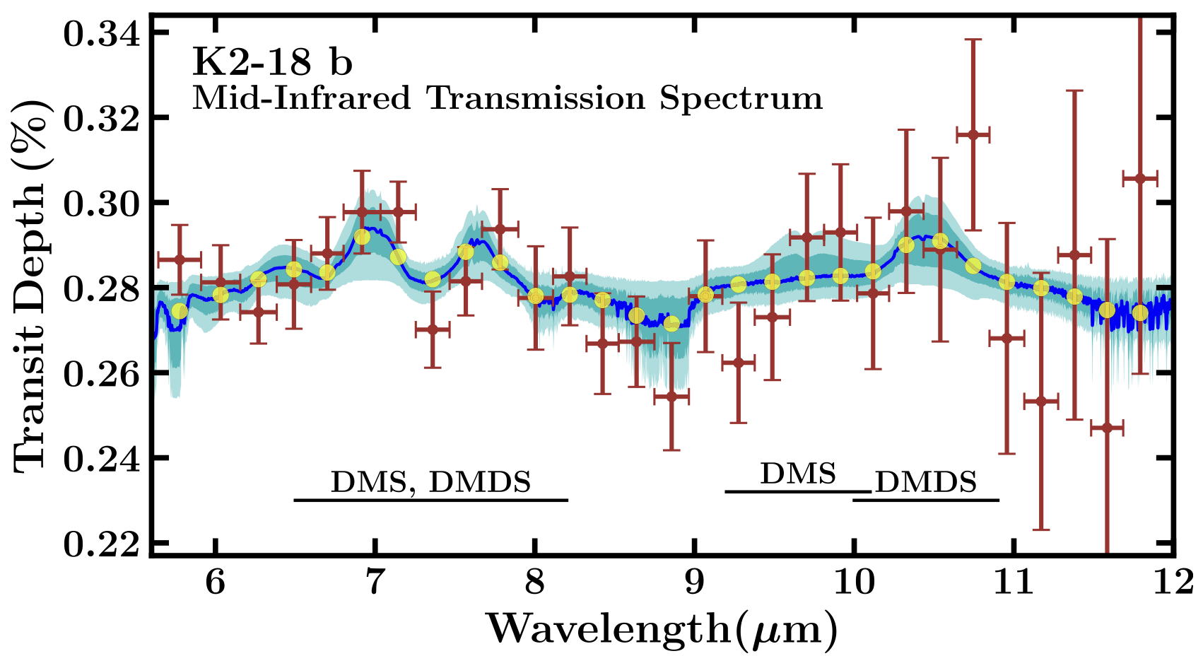
Transmission Spectroscopy
K2-18 b Transmission with NIRISS
(Credit: Madhusudhan et al. 2023)
K2-18 b Transmission with NIRISS
(Credit: Madhusudhan et al. 2025)

Slide 15
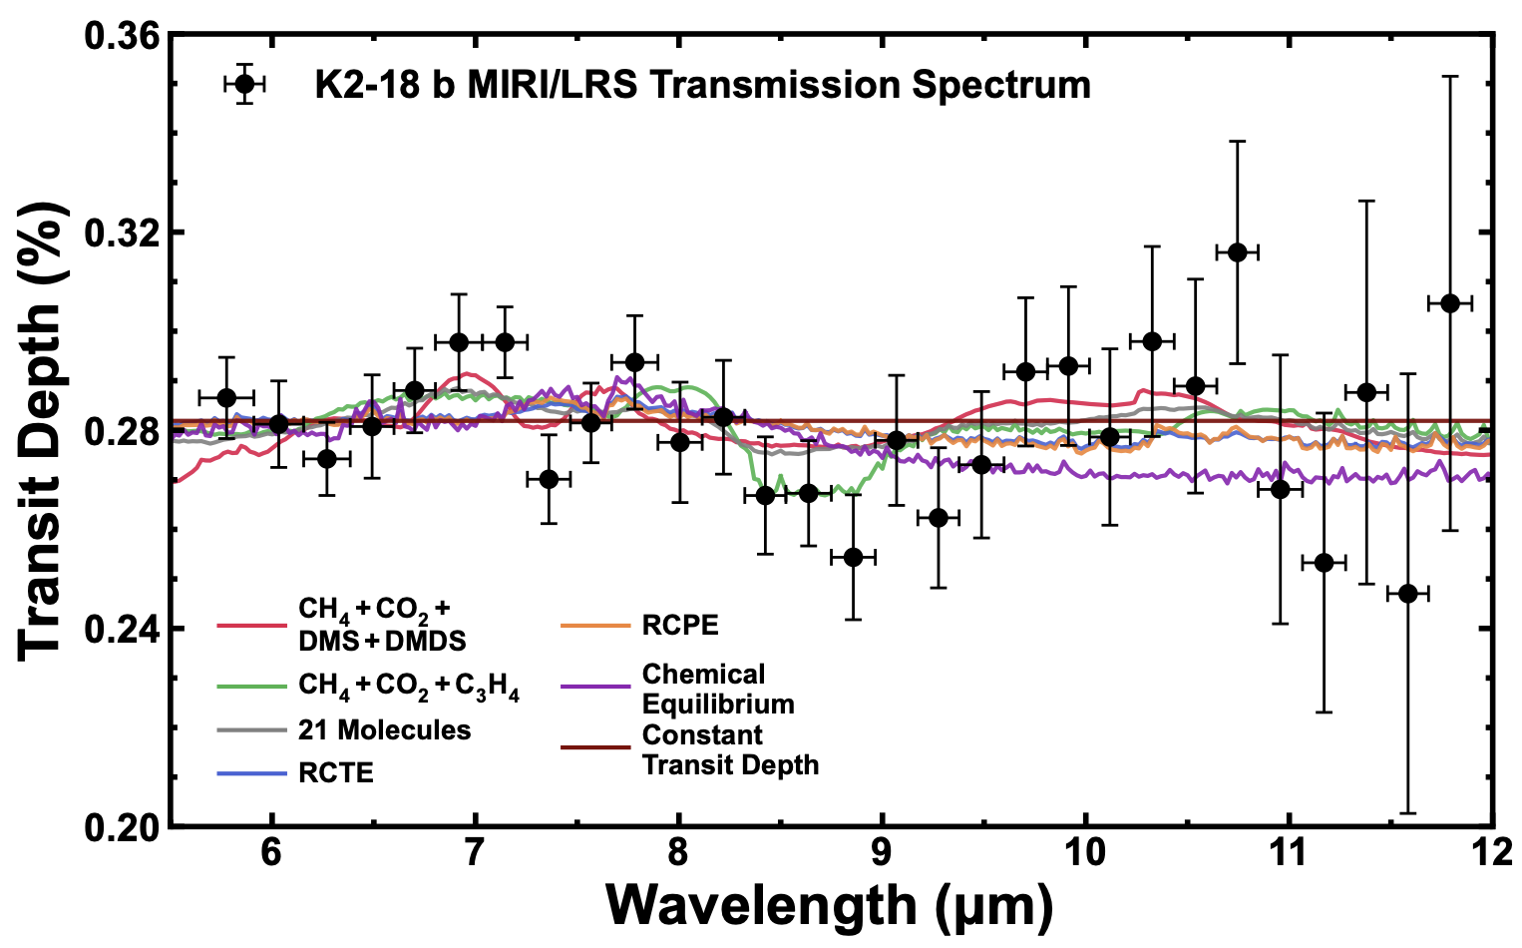
Transmission Spectroscopy
K2-18 b Transmission with NIRISS
(Credit: Madhusudhan et al. 2023)
K2-18 b Transmission with NIRISS
(Credit: Welbanks, L. et al. 2025)
K2-18 b Transmission with NIRISS
(Credit: Madhusudhan et al. 2025)

Slide 16
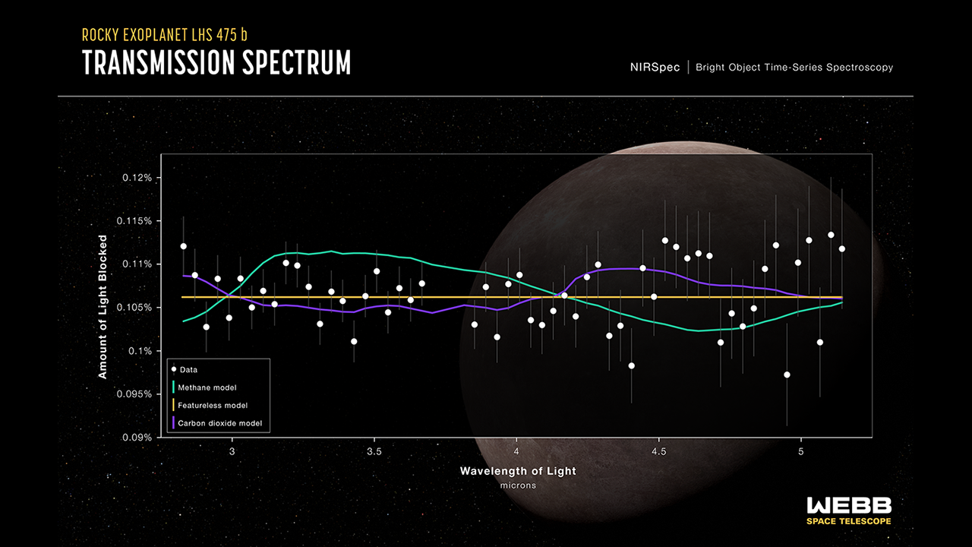
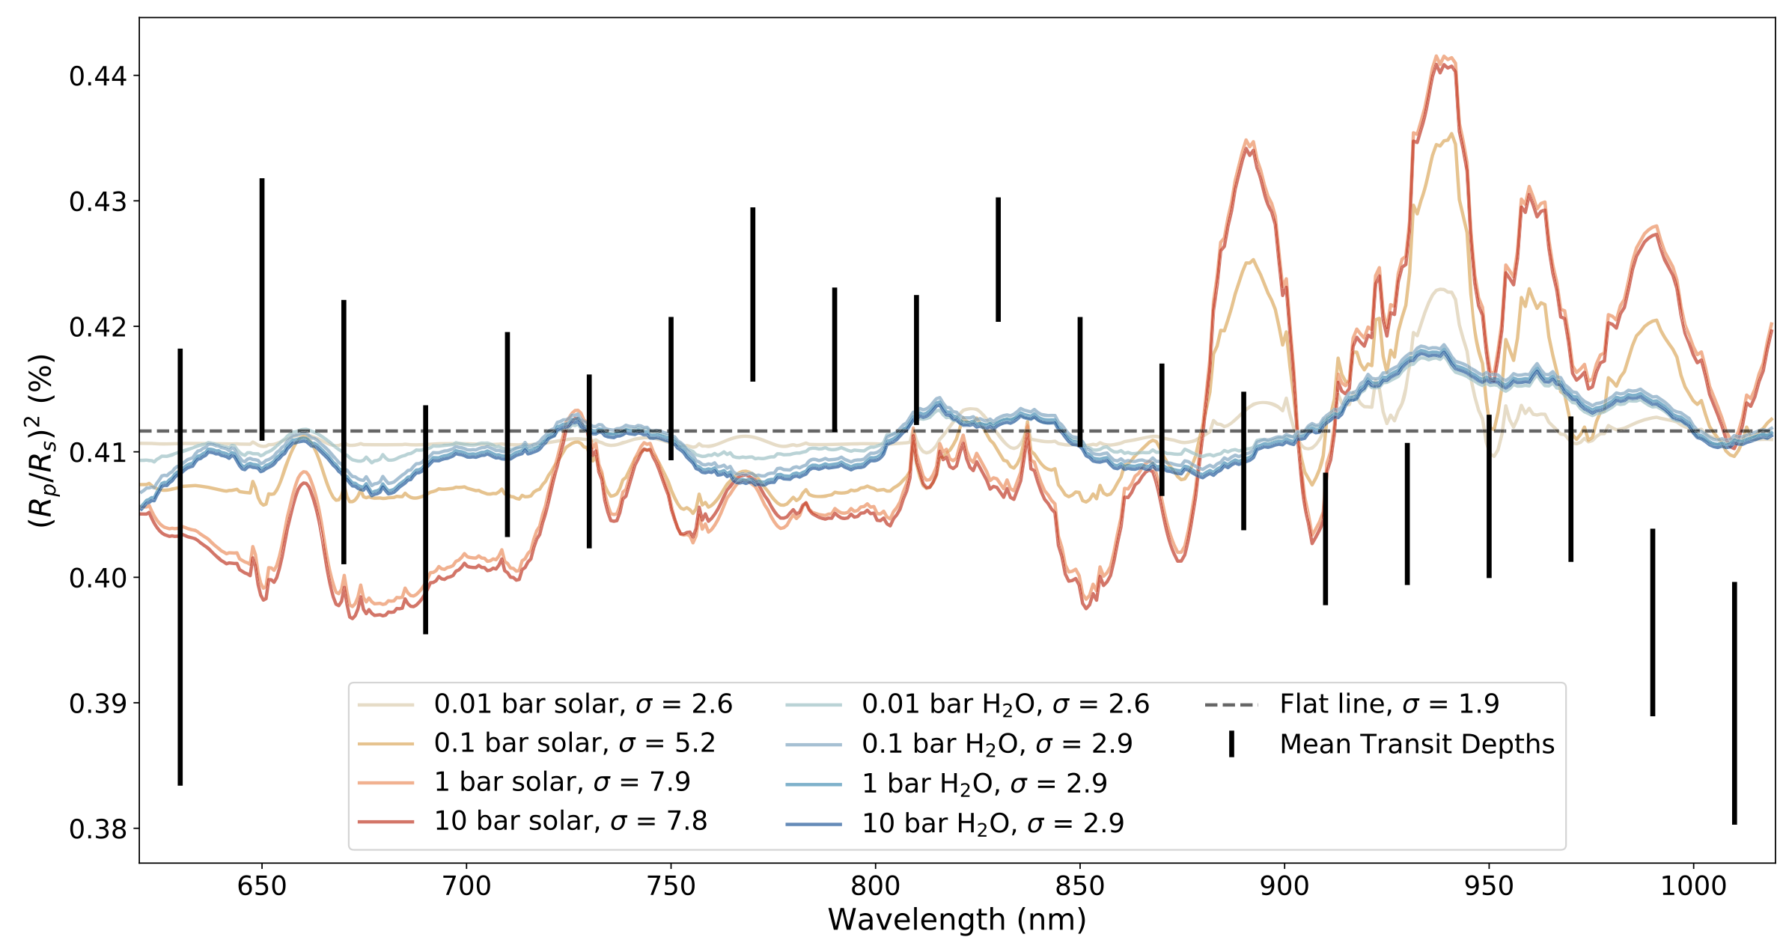
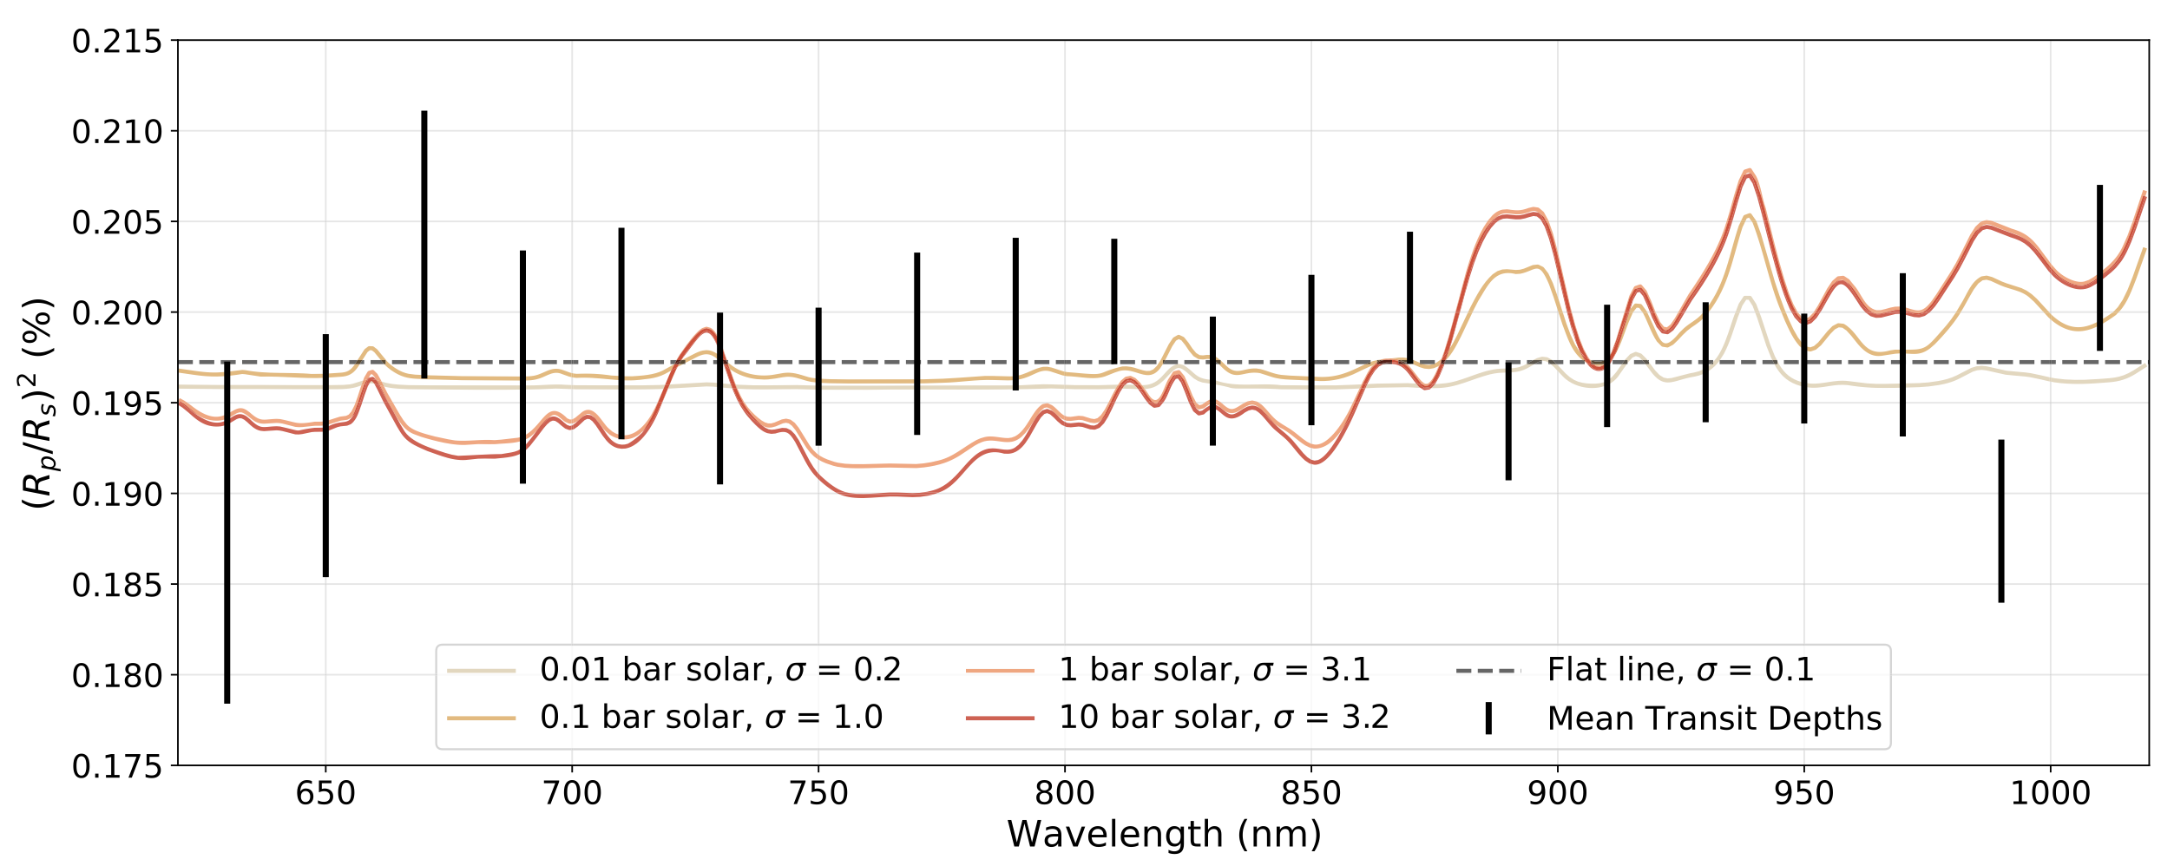
Transmission Spectroscopy
atmospheric study of terrestrial exoplanet is “HARD”
LTT1445Ab transmission spectrum
Credit: Diamond-Lowe, H. et al. (2023)
LHS 475b transmission spectrum
Credit: Lustig-Yaeger, J. et al. (2023)
LHS 3844b transmission spectrum
Credit: Diamond-Lowe, H. et al. (2020)

Slide 17
Transiting exoplanets
Light curve morphology
Transit (Star - Planet shadow)
Phase curve (Star + Planet at that phase)
Secondary eclipse (Star alone)
Exoplanet that we study usually tidally lock
Phase curve (star + planet @ phase)
WASP-43b orbital animation
(Credit: Catriona Murray)
Notes:
-Morphology
-We will used eclipse
-tidally lock

Slide 18
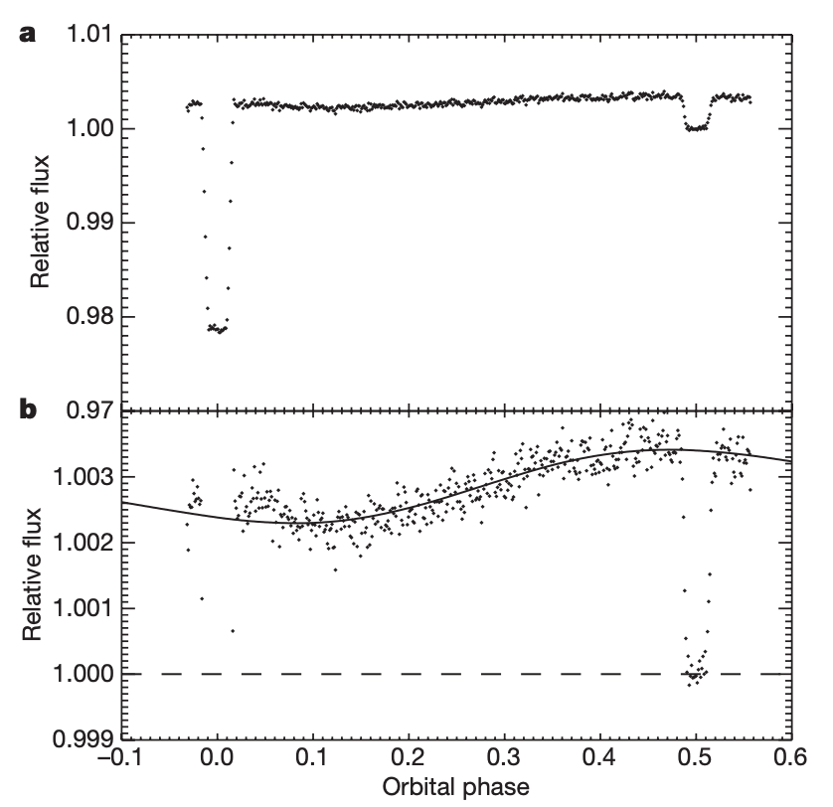
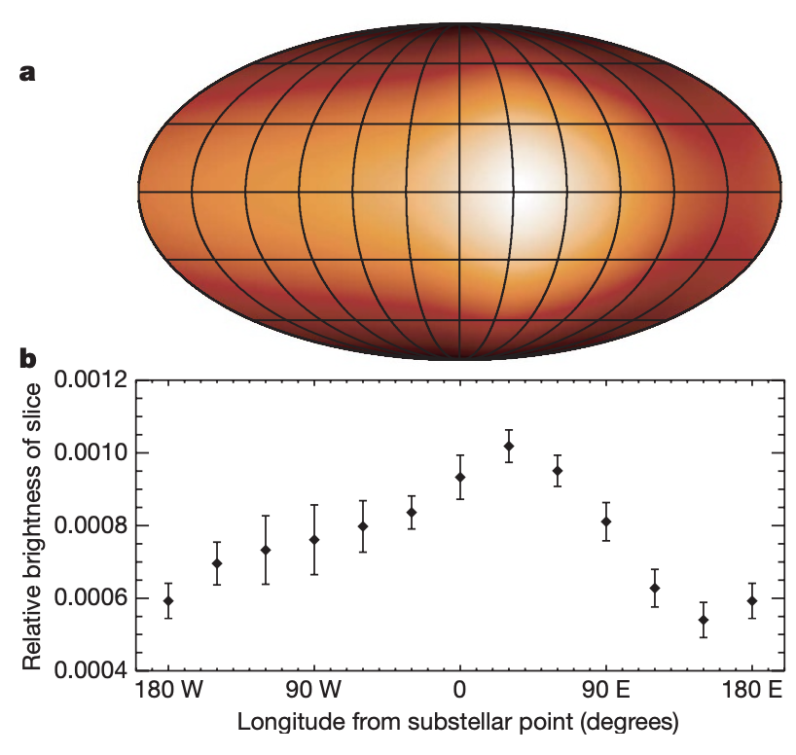
Phase curve variation
Tells us a lot!
Dayside emission
Nightside emission
Planet heat map
Atmosphere Circulation
HD 189733 b light curve from Spitzer
(Credit: Knutson et al. 2007)
Notes:
Add heat map plots

Slide 19
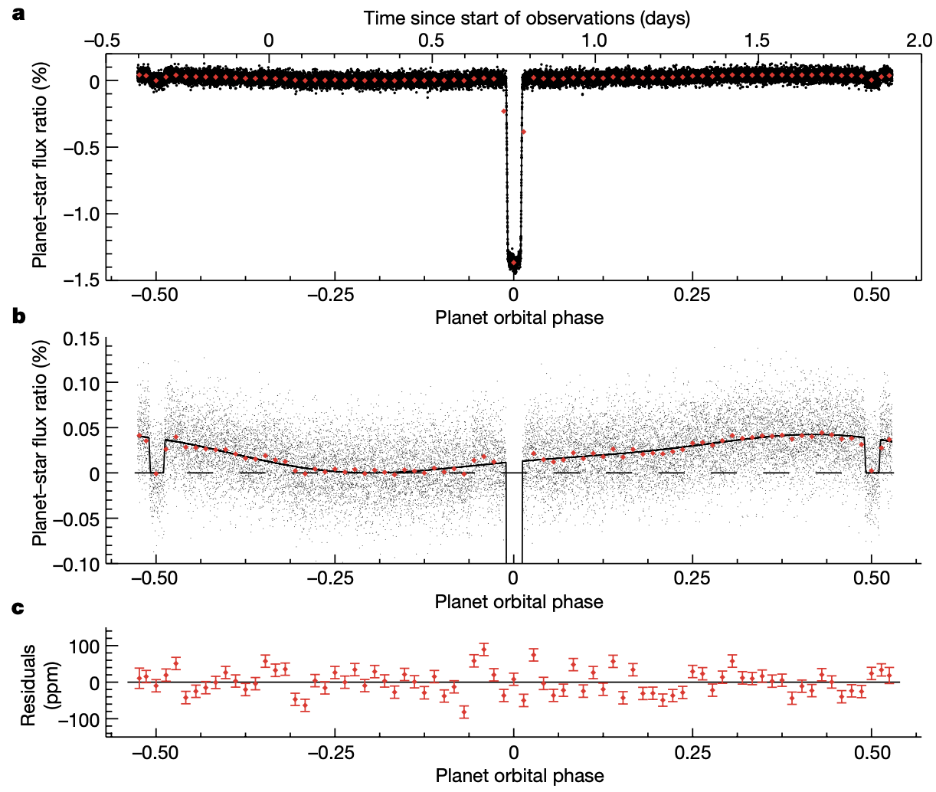
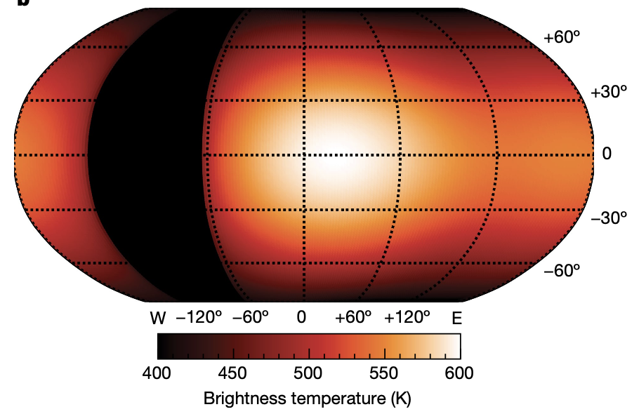
Phase curve variation
Tells us a lot!
Dayside emission
Nightside emission
Planet heat map
Atmosphere Circulation
The white light phase curve of GJ 1214b (P = 37.9 h)
(Credit: Kempton et al. 2023)
Notes:
Add heat map plots

Slide 20
Transiting exoplanets
Light curve morphology
Transit (Star - Planet shadow)
Phase curve (Star + Planet at that phase)
Secondary eclipse (Star alone)
Exoplanet that we study usually tidally lock
Secondary eclipse (star alone)
WASP-43b orbital animation
(Credit: Catriona Murray)
Notes:
-Morphology
-We will used eclipse
-tidally lock

Slide 21
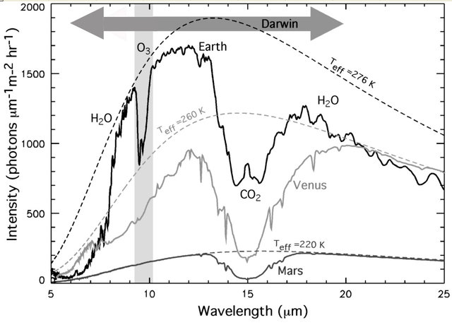
Directly observe Atmospheric absorption features in the spectrum
Flux
Flux
The mid-IR spectrum of the Earth, Venus and Mars at a low resolution
Credit: Cockell, C. S. (2009)
Method I
21
Notes:
The first and most straightforward way is to obtain planet’s thermal emission spectrum and see if there is any atmospheric absorption feature.
For example, on the right are spectra of different Solar system planets
So, if we observe a rocky exoplanet and found an absorption feature at around 10 microns it would indicate a presence of atmosphere though ozone in the atmosphere likewise for CO2 and H2O.

Slide 22
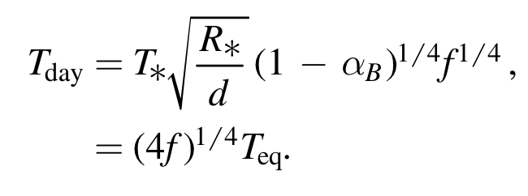
Atmosphere can lower dayside temperature by Part II: Energy Balance
T_{max}
Dayside brightness temperature is a function of heat redistribution factor (f) and Bond albedo (⍺_{B}).
Flux
Flux
Credit: Koll (2022)
Cartoon schematic (top) and simulated spectroscopic light curve (bottom) for each f-factor.
Method II
Notes:
However, only planet dayside temperature can tell us about the presence of the atmosphere too
From energy balance perspective, energy radiated by the planet need to match energy absorb by the planet.
If we have a tidally-locked rocky planet without atmosphere and instantly reradiate heat back up (f=2/3) it would be hot on the dayside and cold on the night side as you see on temperature ratio map the left.
On the other hand, if planet has a thick atmosphere (f=1/4) planet will have uniform temperature though out the planet as you can see on the right.
In this talk, T_max is the maximum dayside-integrated temperature assume f=2/3 and zero albedo.
Using these schematic example, we can build a simulation on what we should see when we observe dayside thermal emission spectrum of each cases.

Slide 23
Atmosphere can lower dayside temperature by Part II: Energy Balance
T_{max}
Dayside brightness temperature is a function of heat redistribution factor (f) and Bond albedo (⍺_{B}).
Flux
Flux
Credit: Koll (2022)
Cartoon schematic (top) and simulated spectroscopic light curve (bottom) for each f-factor.
Method II
Notes:
This spectroscopic light curve shows time on x-axis and wavelength on y-axis and color indicate normalized observe flux at each time and wavelength.
If you slice along x-axis you would get a light curve with secondary eclipse dip in the middle. But if you slice along y-axis, you would get a spectrum at each time.
In here, you can see that the out-of-eclipse baseline of bare-rock model is higher than thick atmosphere, indicate that the dayside is hotter in case of bare-rock
Also, as we progress toward redder wavelength, eclipse depth goes deeper as we expect from blackbody radiation.

Slide 24
Atmosphere can lower dayside temperature by Part II: Energy Balance
Dayside brightness temperature is a function of heat redistribution factor (f) and Bond albedo (⍺_{B}) .
Flux
Flux
Flux
Credit: Koll (2022)
Cartoon schematic (top) and simulated spectroscopic light curve (bottom) for each Bond albedo.
Method II
24
Notes:
- Likewise, planet’s bond albedo also plays role on how much the energy planet can absorb and as we goes from albedo = 0 (absorb everything) to 0.8 (20% absorption) planet’s dayside gets cooler.
- So, from energy balance perspective both from heat redistribution factor and bond albedo, a hot dayside likely indicate lack of atmosphere.

Slide 25
Research question?
Do terrestrial exoplanets around M-dwarf have an atmosphere/what kind?
What is the method should be used?
What target to observe?
What instrument should be used?
Notes:
Research question
- method
- target
- instrument

Slide 26
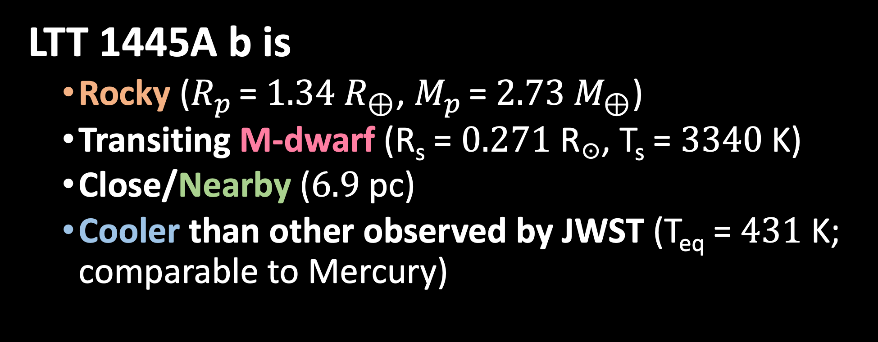
Target
LTT 1445A b is
Rocky ($R_{p}$ = $1.34 R_{⊕}$, $M_{p}$ = $2.73 M_{⊕}$)
Transiting M-dwarf (R_{s} = $0.271$ R☉, T_{s} = $3340$K)
Close/Nearby ($6.9$ pc)
Cooler than other observed by JWST (T_{eq} = $431$ K; comparable to Mercury)
¹ Winters et al. (2019, 2022)
² Pass E. K. et al. (2023)
Notes:
- LTT 1445A b is a rocky planet transiting M-dwarf at 6.9 pc away. It is the outer planet in the triple star system with counter part planet LTT 1445A c will be observed by Rocky World DDT.
- LTT 1445A b is also cooler than other observed by JWST

Slide 27
Where is LTT 1445A b in cosmic shoreline?
Target
Adapt from
Zahnle & Catling (2017)
Wachiraphan et al. (2025)
Notes:
This plot is showing a version of cosmic shoreline plot.
On the x-axis is estimate escape velocity of each planet (similar to ability of planet to hold an atmosphere)
On the y-axis is estimated time-integrated XUV flux received by the planet. The exact calculation and the validity of y value is still a work in progress but this is the first proxy to determine the violence of the host star to strip away an atmosphere.
Blue line indicate the cosmic shoreline suggested by Zahnle & Catling (2017) while gray line is the simple balance between thermal and gravitational energies. Planets on the right of this line are likely sustain atmosphere while planets on the left cannot.
For comparison, we put several solar system planetary bodies such as Venus, Earth, Mars, titan
Only Venus and Earth has 100 bar CO2 (if we consider CO2 locked in limestone in Earth ocean)
LTT 1445A b is one of the closest to this shoreline and determining whether or not this planet host a significant atmosphere will enable the study of the validity of the shoreline.

Slide 28
Research question?
Do terrestrial exoplanets around M-dwarf have an atmosphere/what kind?
What is the method should be used?
What target to observe?
What instrument should be used?
Notes:
Research question
- method
- target
- instrument

Slide 29
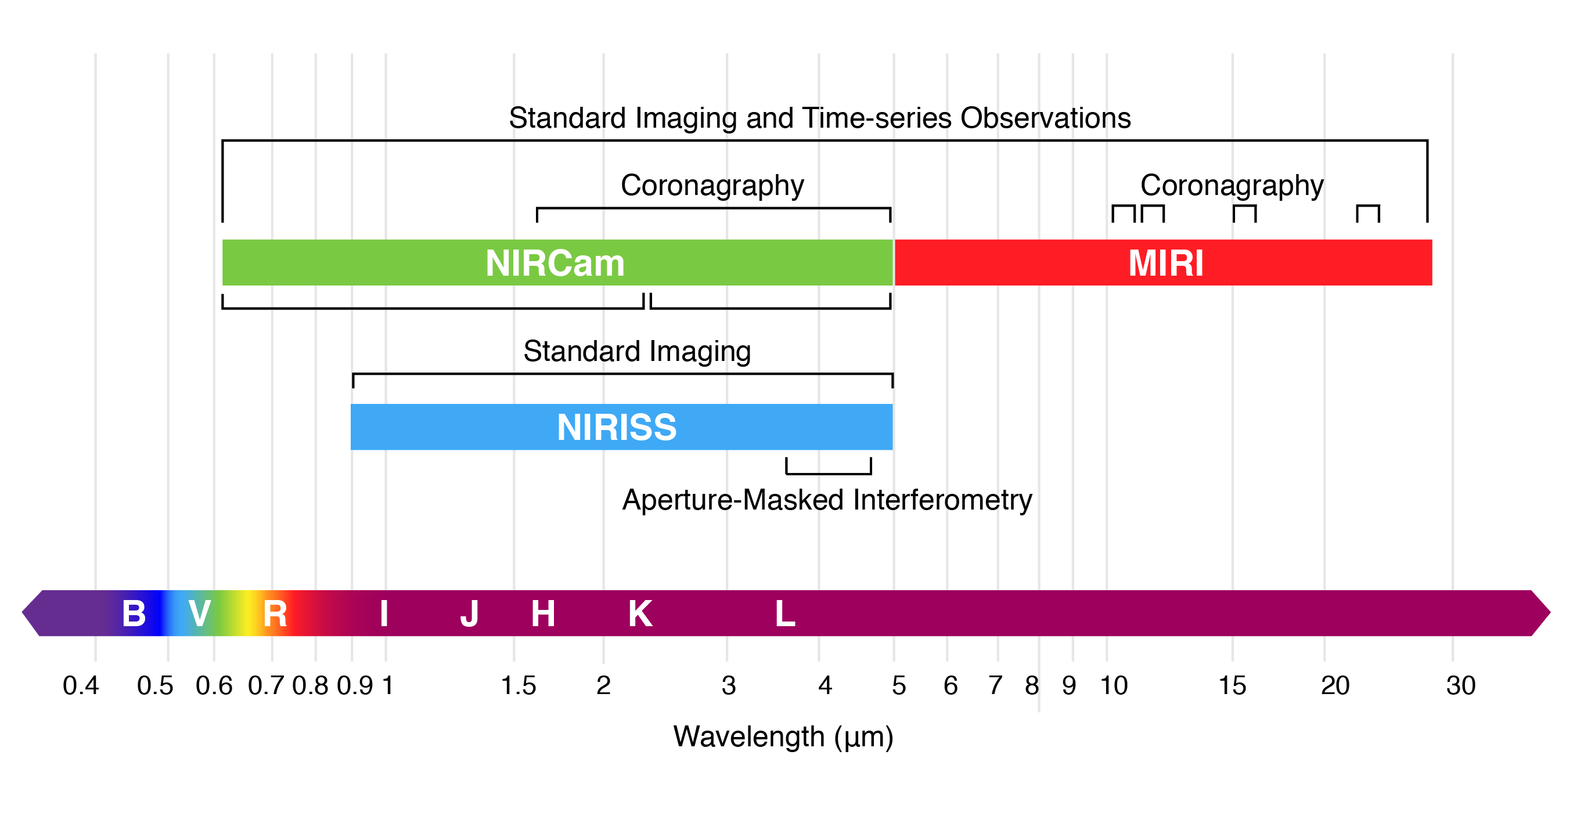
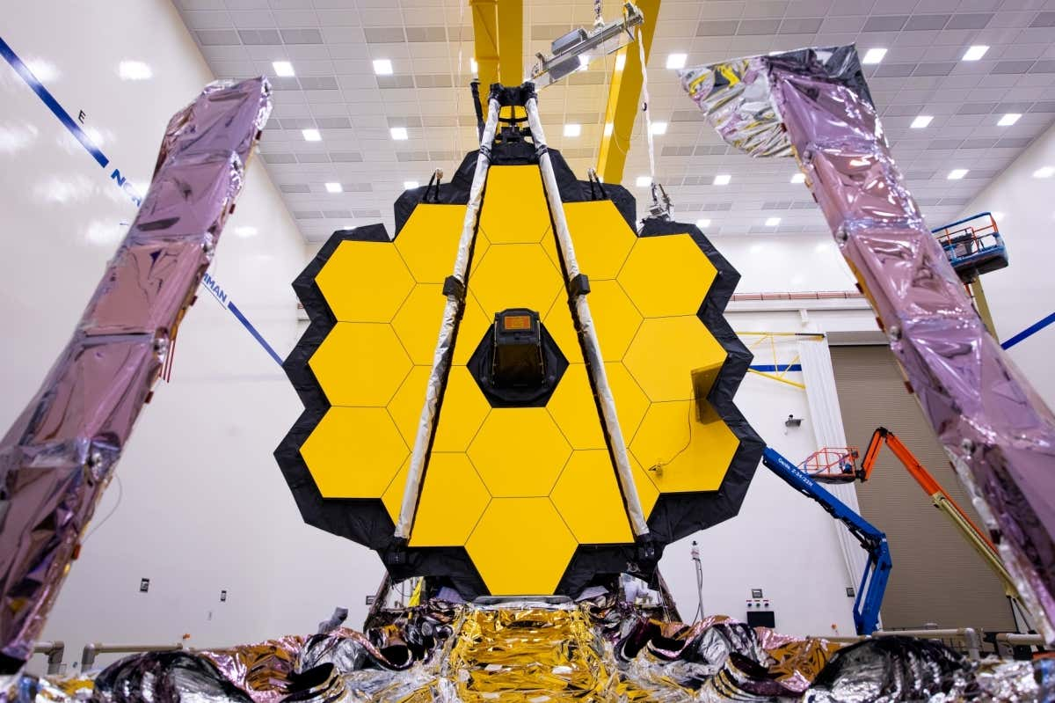

We need to maximize the contrast ($\frac{F_{p}}{F_{s}}$)
https://jwst-docs.stsci.edu/methods-and-roadmaps/jwst-imaging#gsc.tab=0
Credit: NASA
Wachiraphan et al. (2025)

Slide 30
What did we learn about LTT 1445A b?
Results

Slide 31
Results
Wachiraphan et al. (2025)
Notes:
We observed total of 3 eclipses of LTT 1445A b
We then compared the results from two reduction pipeline SPARTA and Eureka
<at this binning we are not expect to see eclipse because it is a lot less than systematics and noise level in here>
As you can see, we are seeing a bunch of systematics which we simultaneously fit with the eclipse model.
We also see a flip of exponential ramp in shadow region. such as exponential ramp at the start of observation This shadow region have been seen by several but not all MIRI/LRS observation. We then, exclude them from our final analysis
We also see a mysteries jump in visit 3. We then, cut off the data before the jump.

Slide 32
Results
Systematic-corrected broadband light curve
Wachiraphan et al. (2025)
Notes:
We confidently detect the eclipses
Visit 2 is deeper not sure why (no obvious systematics in raw data)
Artificially inflate the uncertainty of combined visits so that it captures all three visits

Slide 33
3 eclipses-combined 2D systematics-corrected JWST MIRI/LRS spectroscopic light curve shows an eclipse
Results
Relative flux
Relative flux
Wachiraphan et al. (2025)
Notes:
This is the 3 eclipses combined 2D map of a systematic-corrected panchromatic light curve as you saw earlier. The x-axis shows time, and the y-axis shows wavelength. The colormap shows flux at any particular time and wavelength.
You can see the <click> eclipse in the data, and as we progress toward a redder wavelength, the depth increases as we expected from black body. <Call back to simulation earlier>

Slide 34
We averaged three eclipses together to get more robust emission spectrum
Results
Eureka! (grey) and SPARTA (color) emission spectrum
Wachiraphan et al. (2025)
34
Notes:
This is the emission spectra plot with wavelength on the x-axis and eclipse depth on the y-axis. You can see that most of the depths from two independent reduction pipelines (Eureka in grey and SPARTA in color) agreed within 1σ especially in combined three eclipses, except for one in the shadowed region after 10.6 microns, highlighted in the grey band.
We ultimately chose SPARTA’s product due to its lower scatter.

Slide 35


We don’t see any absorption features expected from thick atmosphere
Results
The dayside temperature is consistent with bare-rock
Forward model perspective
Pure CO₂ atm. -> thin (<1 bar) pure CO₂ still allowed
Planck -> consistent with bare-rock
Morley et al. (2017)
Wachiraphan et al. (2025)
35
Notes:
<click> This is the same of what you saw in previous slide, which is a dayside emission spectrum of the planet. In here, we shows pure CO2 atmospheres, as described in Morley et al. (2017).You can see that there are no obvious features that match the data, and the Pure CO2 with surface pressure over 1 bar are all rejected at more than 4.2 sigma. However, thinner pure CO2 atmospheres are still allowed.
On the right is the Planck spectra at different heat redistribution factors and albedo. Perfect heat redistribution cases are all ruled out over 4.6 sigma, and the best-fit dayside temperature is pretty close but a little below expected from bare-rock model.
We then used the fitted dayside temperature to

Slide 36
Planet’s dayside is too hot for a very thick and/or very reflective atmosphere
Results
Energy balance perspective
Venus-like is ruled out at 7σ.
Earth-like and Titan-like are still allowed within 1.6σ.
Best-fit
Koll et al. (2022)
Wachiraphan et al. (2025)
R = 0.952 ± 0.057
36
Notes:
<click> calculated temperature ratio R compared to the maximum possible temperature from the bare-rock model. This is the temperature ratio as a function of Bond albedo and inferred surface pressure from Koll 2022. a higher albedo and/or surface pressure <click> resulted in cooler dayside either from heat redistribution and/or high albedo cloud. We put different solar system planet analogs <click> for context here.
Our best fit showed as a <click> here as well as 1sigma and 3sigma error.
From an energy balance perspective, a thick and reflective atmosphere like Venus is ruled out at 7sigma. Moderately thin and reflective atmospheres like Titan and Earth are plausible within 1.6sigma. Thinner atmospheres like Mars Moon and Mercury are within 1sigma error.

Slide 37

Conclusion & Next step for LTT 1445A b
Both energy balance and forward model disfavor a thick 100 bar CO₂ atmosphere (Venus-like)
A moderately thin (<1 bar) atmosphere is still allowed.
Further investigation at CO₂ absorption band (15 μm) is needed to rule out a thinner CO₂-rich atmosphere.
JWST transits of the system can vastly improve the system’s parameters and constrain the results more.
37
DOI: 10.3847/1538-3881/adc990

Slide 38
Dayside thermal emission of Solar System planets
Rocky Worlds DDT will provide spectra of rocky exoplanets at 15 μm
We will construct reference dayside emission spectra of Solar system planets
What do Solar system planets look like at 15 μm
Wachiraphan et al. (2025)
38
Notes:
rocky worlds DDT will observe a number of planets at 15 microns
Right now, there is a lack of connection between well-observed and understand Solar system planets and what we expected from rocky exoplanets
Especially, <click> what do Solar system planets look like at 15 microns
<click> We will construct reference dayside emission spectra of Solar system planets to use for comparison

Slide 39
Dayside thermal emission of Solar System planets
T_{day,Moon} = 357 K
Simulated disk-integrated spectra of Earth and Moon dayside
T_{day,Earth} = 256 K
39
Notes:
On the right here is real data show real temperature map of the Moon using data from LRO/Diviner (top) and Earth from Aqua/AIRS.
This is a very good case study of the effect of thinner atmosphere (~1 bar) on thermal emission spectrum.
Earth and Moon receive similar Solar radiation but since Moonis a bare-rock, it reradiate energy right away and have a hot dayside about 357 K
In case of the Earth, with the help of atmosphere, day-night contrast is less prominent as you can see from the map.
The shape of data tied back to the fact that spacecraft is in “afternoon constellation” orbit meaning it will always observing ~1:30 am and pm solar time.

Slide 40
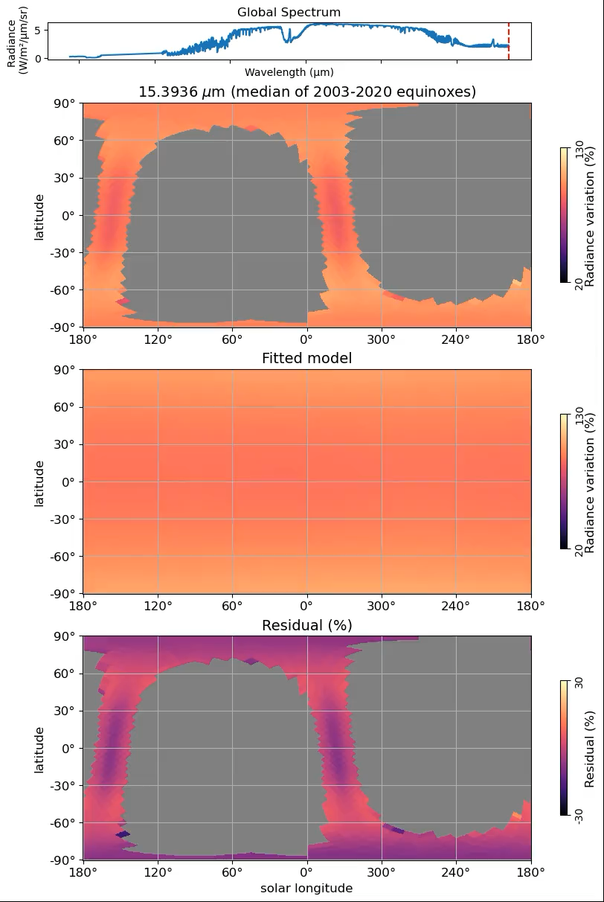
Dayside thermal emission of Solar System planets
40
Notes:
On the right here is real data show real temperature map of the Moon using data from LRO/Diviner (top) and Earth from Aqua/AIRS.
This is a very good case study of the effect of thinner atmosphere (~1 bar) on thermal emission spectrum.
Earth and Moon receive similar Solar radiation but since Moonis a bare-rock, it reradiate energy right away and have a hot dayside about 357 K
In case of the Earth, with the help of atmosphere, day-night contrast is less prominent as you can see from the map.
The shape of data tied back to the fact that spacecraft is in “afternoon constellation” orbit meaning it will always observing ~1:30 am and pm solar time.

Slide 41
Back up slide

Slide 42
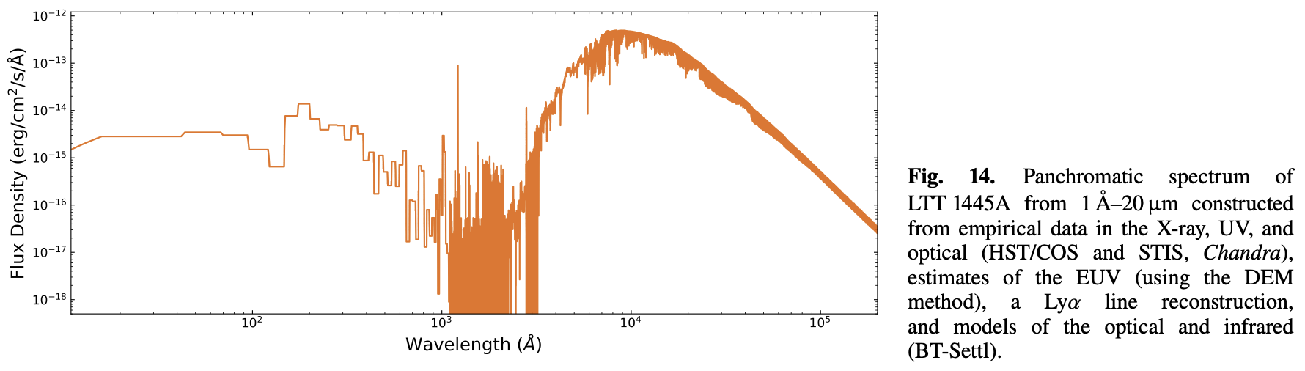
Diamond-Lowe, H. et al. 2024
Wachiraphan et al. (2025)
42
Notes:
rocky worlds DDT will observe a number of planets at 15 microns
Right now, there is a lack of connection between well-observed and understand Solar system planets and what we expected from rocky exoplanets
Especially, what do Solar system planets look like at 15 microns
We will construct reference dayside emission spectra of Solar system planets to use for comparison

Slide 43
Wachiraphan et al. (2025)
43
Notes:
rocky worlds DDT will observe a number of planets at 15 microns
Right now, there is a lack of connection between well-observed and understand Solar system planets and what we expected from rocky exoplanets
Especially, what do Solar system planets look like at 15 microns
We will construct reference dayside emission spectra of Solar system planets to use for comparison

Slide 44
We averaged three eclipses together to get more robust emission spectrum
Eureka! (grey) and SPARTA (color) emission spectrum
Notes:
This is the emission spectra plot with wavelength on the x-axis and eclipse depth on the y-axis. You can see that most of the depths from two independent reduction pipelines (Eureka in grey and SPARTA in color) agreed within 1σ especially in combined three eclipses, except for one in the shadowed region after 10.6 microns, highlighted in the grey band.
We ultimately chose SPARTA’s product due to its lower scatter.

Slide 45
Notes:
One of the leading theories is the cosmic shoreline, proposed by Zahnle and Catling (2017) suggests the empirical boundary separating planets that can hold an atmosphere and those that likely cannot as you can see in this plot as a blue line. The x-axis represent a planet's ability to hold an atmosphere while y-axis represent ability of host star to strip away atmosphere. We also put several solar system bodies as a comparison.
For instance, Kreidberg et al. (2019) and Crossfield et al. (2022) utilized this technique to analyze the emission spectrum of LHS3844b and GJ1252b using Spitzer’s IRAC (4.5 micron) instrument. Both studies concluded that neither planet exhibited significant atmospheric features. Building on this, we employed the James Webb Space Telescope (JWST) to investigate several rocky planets using the same technique on both the MIRI/LRS and MIRI/F1500W instruments. The results revealed that the data from GJ 367b, Trappist-1b GJ 1132b, and Trappist-1c GJ 486b all indicated the presence of bare rock. However, Trappist-1c and GJ 486b exhibited slightly lower temperatures compared to bare rock, suggesting the existence of a non-zero albedo or a thin atmosphere. Notably, Hu et al. and Patel et al. (2024) found a CO/CO2-rich atmosphere likely outgassing from a magma ocean on 55 Cancri e (Teq ~2000K).

Slide 46
Broadband light curve

Slide 47
Scatter comparison

Slide 48
Flux comparison

Slide 49
Posterior ecosw and esinw

Slide 50
Dayside temp at different
binning scheme

Slide 51
We averaged three eclipses together to get more robust emission spectrum
Eureka! (grey) and SPARTA (color) emission spectrum
Notes:
This is the emission spectra plot with wavelength on the x-axis and eclipse depth on the y-axis. You can see that most of the depths from two independent reduction pipelines (Eureka in grey and SPARTA in color) agreed within 1σ especially in combined three eclipses, except for one in the shadowed region after 10.6 microns, highlighted in the grey band.
We ultimately chose SPARTA’s product due to its lower scatter.

Slide 52
Cosmic shoreline

Slide 54
Fun demos

Slide 55
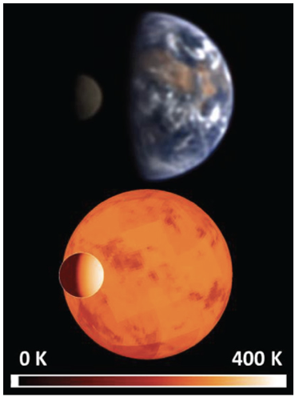
We can search for atmospheres of rocky exoplanets via the planet’s emission spectrum during a secondary eclipse
Method
True color picture of Earth and Moon from NASA’s EPOXI.
Earth
Night
side
Day
side
Simulated image at 10 μm
Credit: Robinson, T. (2011)
Notes:
To answer this question, we can search for the atmospheres of rocky exoplanet by observing their secondary eclipse and determining their dayside temperature whether it is very hot like Moon’s dayside or less hot like Earth-analog.

Slide 56
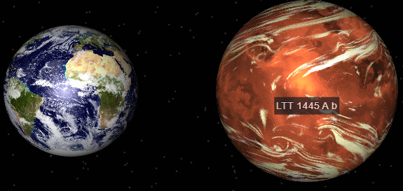

What is the target? (LTT1445Ab!)
LTT1445Ab
Host star: LTT1445A (Triple star system)
M3.0V
R = ${0.271}_{−0.010}^{+0.019}$ R☉
M = 0.257 $±$ 0.014 M☉
T_{eff} = 3340 $±$ 150 K
Planet b
Period ${5.3587635}_{−0.0000045}^{+0.0000044}$ d
Inclination 89.53 deg
S = ${5.7}_{−1.1}^{+1.3}$ $S_{⊕}$
A size comparison of LTT 1445 A b and the Earth,
created in the NASA Exoplanet Catalog.

Slide 57
Sun
M3V
LTT1445Ab
0.01228 R☉
S = 5.7 S⊕
LTT1445A
0.271 R☉
S_{Mercury} = 6.6 S⊕
To scale
Notes:
However, rocky planets around Sun-like stars create such small and hard-to-detect signals. This is why we study LTT1445Ab, a most accessible rocky exoplanets orbiting smaller M3 star. It receive bolometric flux ~5.4 of the Earth comparable to Mercury’s

Slide 58
We use thermal emission to probe LTT1445Ab's atmosphere.
WASP-43b orbital animation
(Credit: Catriona Murray)
Secondary Eclipse (Star alone)
Notes:
Let's discuss how we can confirm or deny the presence of an atmosphere using the secondary eclipse light curve. <click> During a secondary eclipse, when the planet is behind the star, we see the planet’s thermal emission disappear.

Slide 59
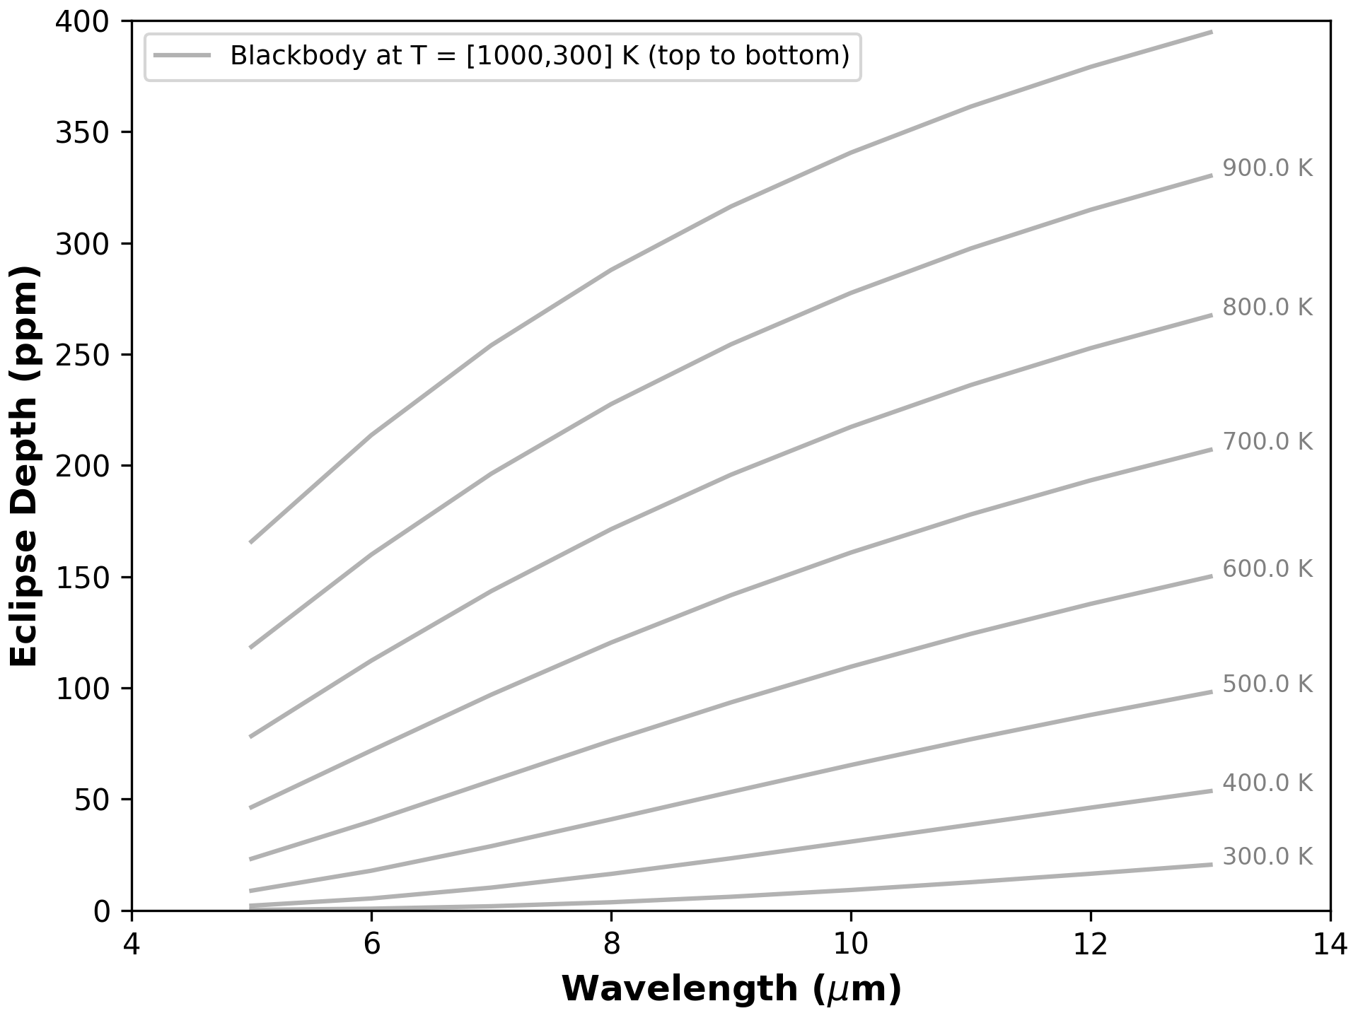
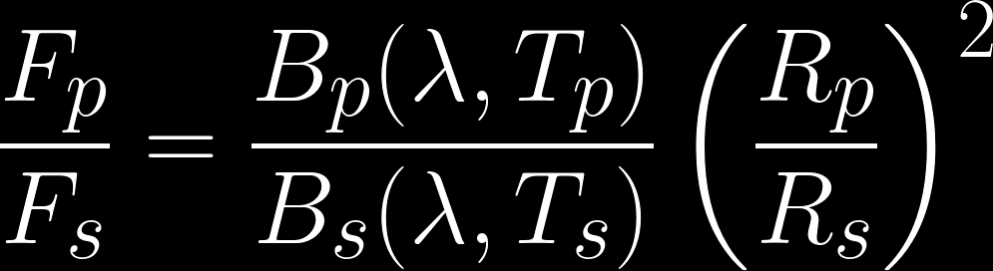
The eclipse depth tells us the dayside temperature.
Depth
Blackbody of planet
Radius
ratio
(constrain
from
Transit)
Blackbody of star
Notes:
The depth of the secondary eclipse can be described <click> as the ratio between the flux of the planet and the flux of the star, <click> a function of temperature. <click> On the right hand side is the plot of eclipse depth as function of wavelength at different dayside temperature. You can see that lower planet temperature will create shallower eclipse. But, how dayside brightness temperature tied to the presence of atmosphere?

Slide 60
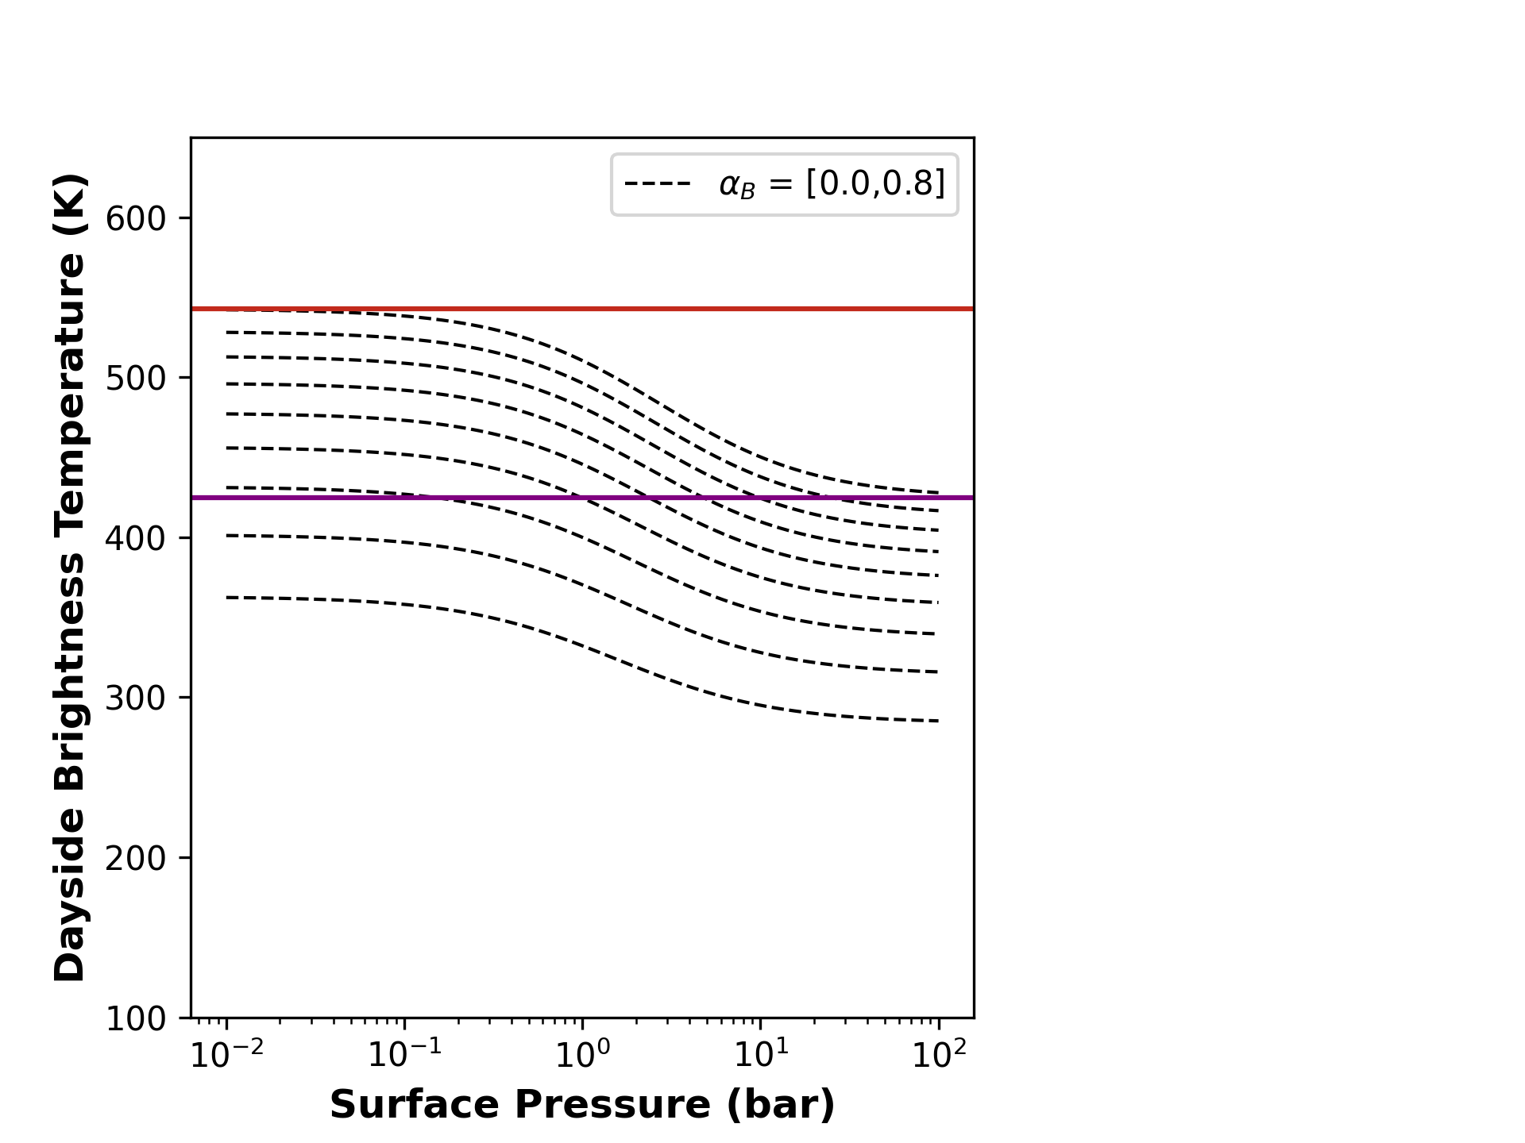
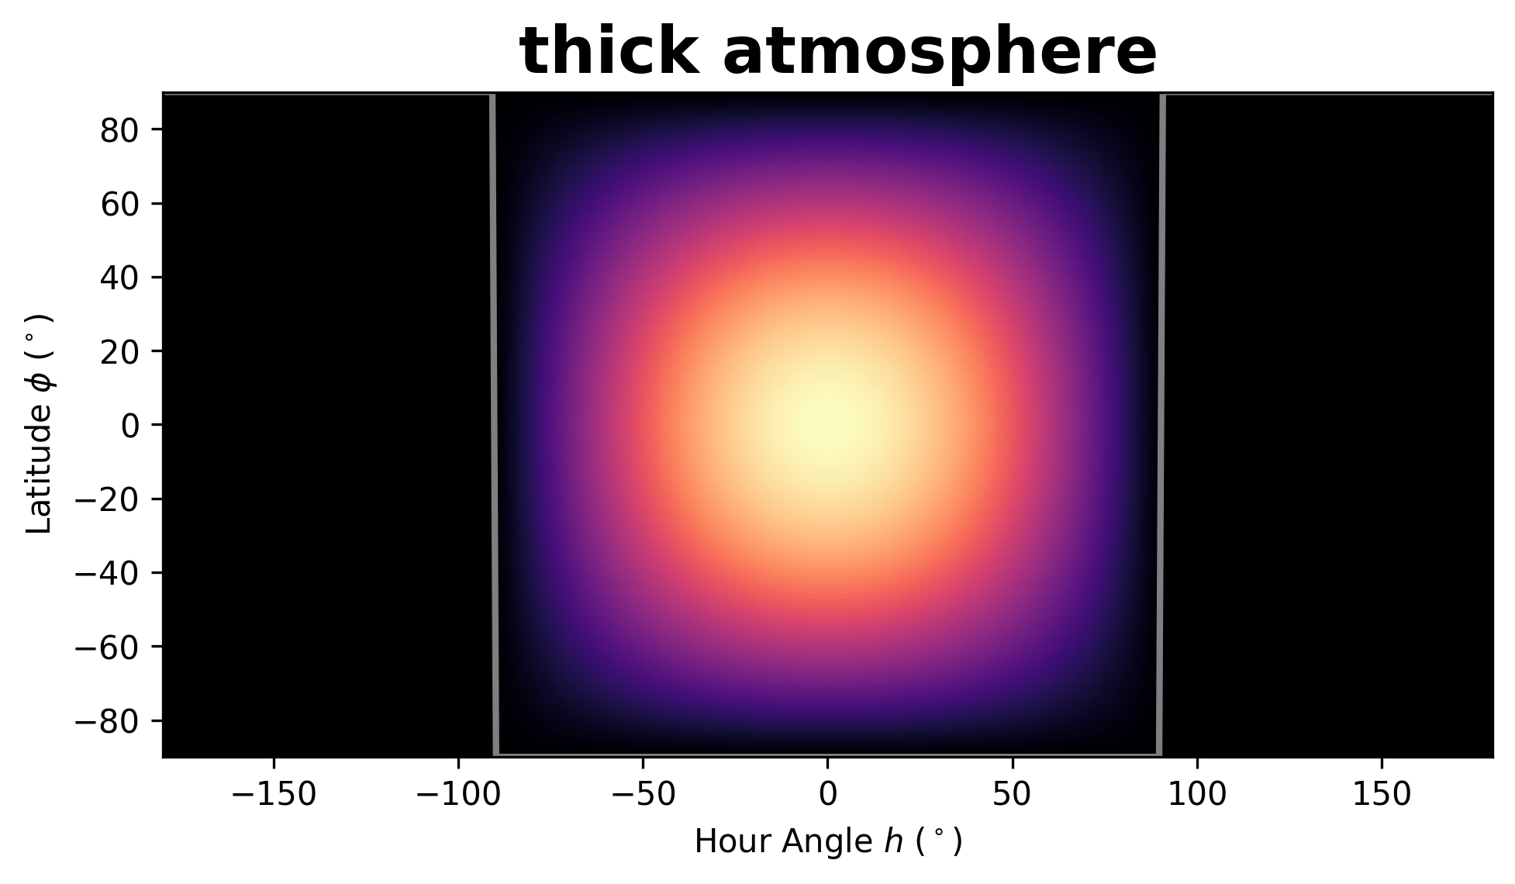
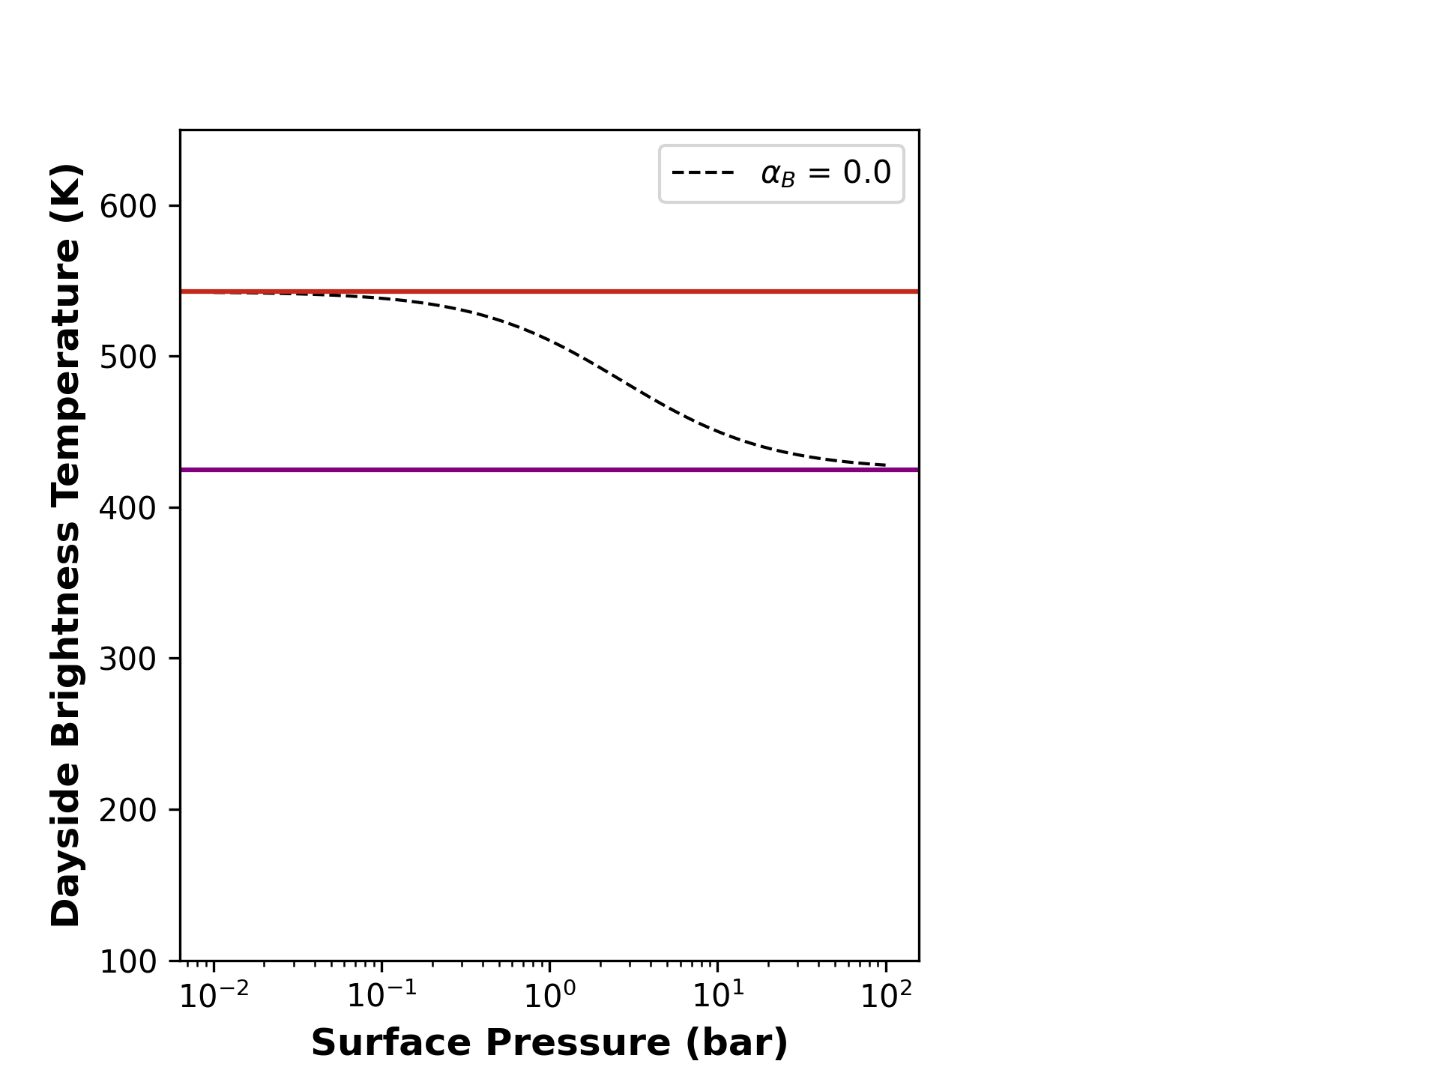
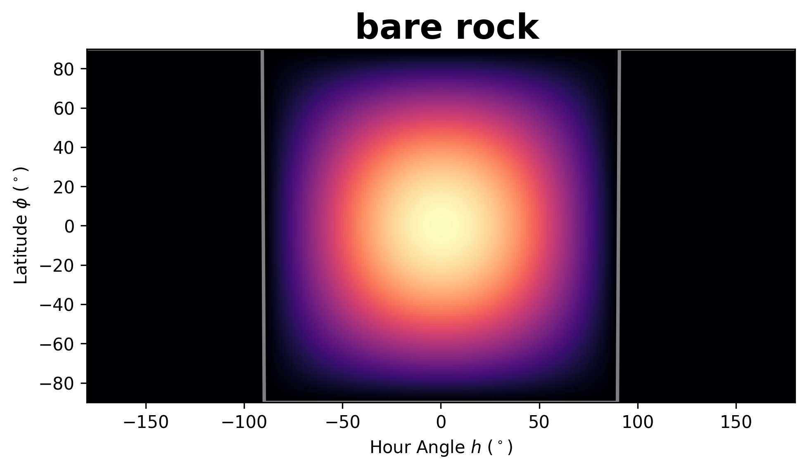
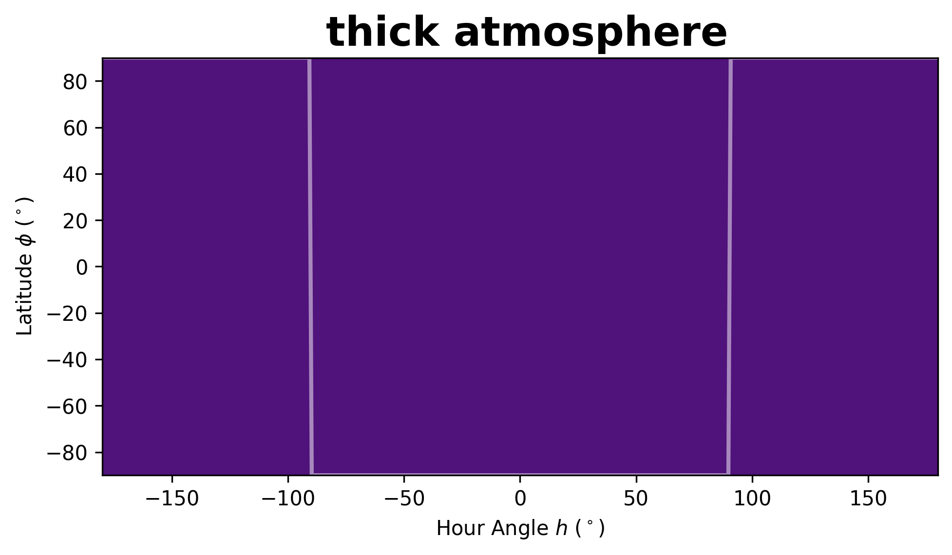

albedo = 0
Mercury-like
Venus-like
(but low albedo)
albedo = 0.8
Tidally-locked rocky exoplanet heat redistribution
(Koll, 2022)
High albedo cloud
(Mansfield et al., 2019)
Notes:
This plot shows the relationship between dayside brightness temperature and planet's surface pressure, as described in Koll's 2022 paper. A tidally-locked rocky exoplanet without an atmosphere (Mercury-like) <click> would have a higher dayside temperature than its thick atmosphere <click> (Venus-like) counterpart. If we measure a high dayside brightness temperature, it might indicate a no-atmosphere scenario, whereas a low temperature might suggest the presence of an atmosphere through heat re circulation or <click> highly reflective cloud as describe in Mansfield et al. (2019)

Slide 61
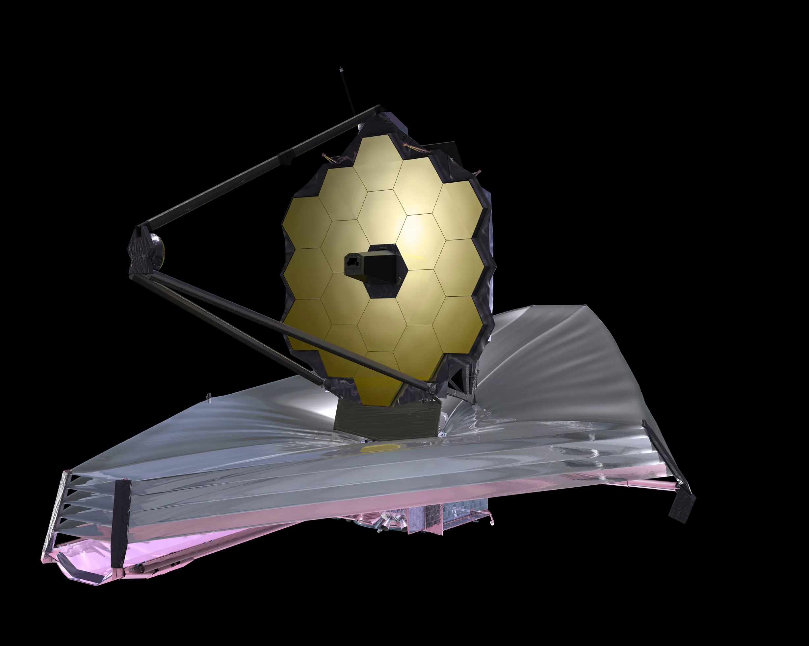
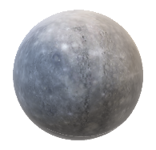
Bell, T. et al. (2022)
EUREKA!
Reduction pipeline
Eclipse depth fitting
Dayside temp.
fitting
JWST MIRI/LRS data of LTT1445Ab secondary eclipse
(3 visits)
High: bare-rock
Low: Atmosphere?
LTT1445Ab spectroscopic light curve
LTT1445Ab thermal emission spectrum
SPARTA
Reduction pipeline
https://github.com/ideasrule/sparta
chromatic_fitting Murray, C. et al. (in prep.)
Notes:
To achieve this, we utilized <click> JWST MIRI/LRS to observe 3 visits of secondary eclipse, <click> employing two data reduction pipelines—EUREKA! and SPARTA. <click> We performed a two-step fitting process, starting with eclipse depth fitting and followed by dayside temperature fitting. A high temperature may suggest a bare-rock model, while a low temperature might indicate the presence of an atmosphere.

Slide 62
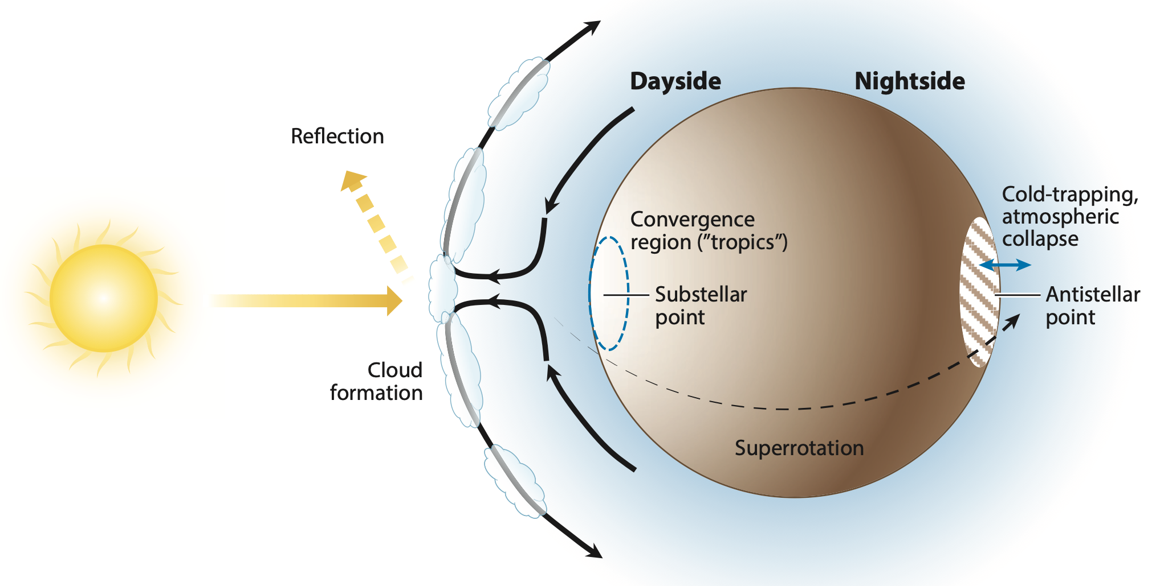
Climate processes Credit: Wordsworth & Kreidburg 2022

